Slide 1
Physical Chemistry III (728342) Introduction to Quantum Theory
Piti Treesukol
Kasetsart University
Kamphaeng Saen Campus
http://hyperphysics.phy-astr.gsu.edu/hbase/quacon.html#quacon

Slide 2
Failures of Classical Physics
Some situations where classical physics fails
Photoelectric Effect
Black-body Radiation
Line Spectra
Compton Scattering
Wave Properties of Electron

Slide 3
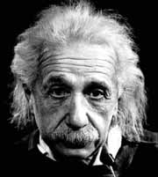
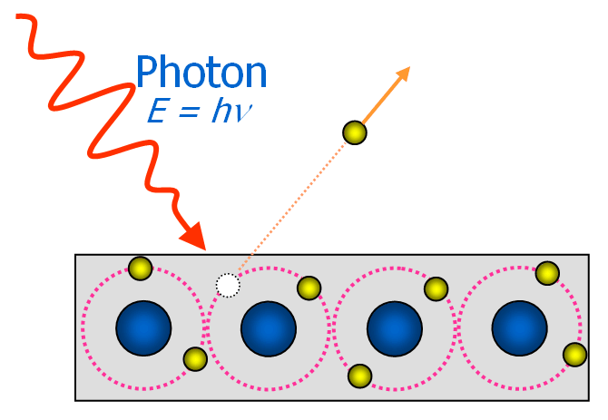
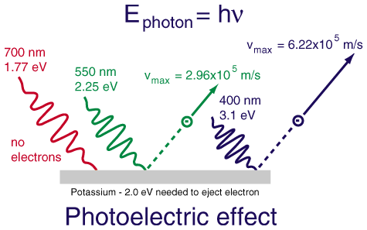
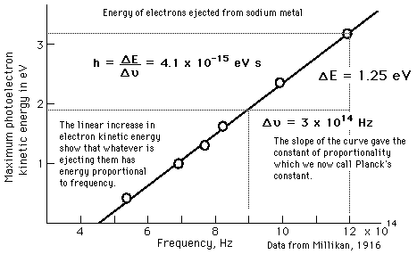
Photoelectric Effect
Albert Einstein
The photoelectric effect is the emission of electrons from matter upon the absorption of electromagnetic radiation.
The photon is the quantum of the electromagnetic field (light).
If an electron in atom absorbs the energy of one photon and has more energy than the work function, it is ejected from the material.
Increasing the intensity of the light beam does not change the energy of the constituent photons, only their number.

Slide 4
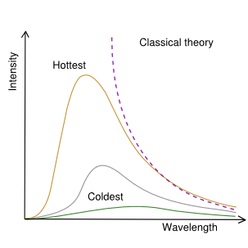
Black-Body Radiator
A black body is an object that absorbs all electromagnetic radiation that falls onto it.
The amount and type of electromagnetic radiation they emit is directly related to their temperature.
A hot object emits electromagnetic radiation.
The light emitted by a black body is called black-body radiation
Black-body or hot cavity
1000 2000 3000 4000 5000 6000 7000 8000 9000 10000 K

Slide 5
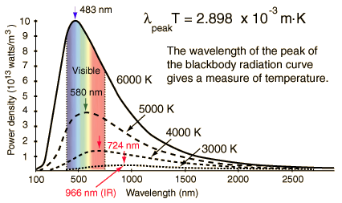
Black-Body Radiation
Blackbody radiator refers to an object or system which absorbs all radiation incident upon it and re-radiates energy which is characteristic of this radiating system only.
When the temperature of a blackbody radiator increases, the overall radiated energy increases and the peak of the radiation curve moves to shorter wavelengths.
Can’t be explained by classical physics
Wien Displacement Law
Stefan-Boltzmann Law

Slide 6
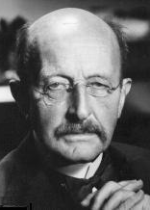
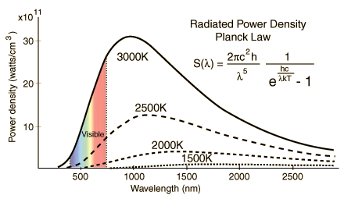
Planck Hypothesis
Max Planck
Planck suggested that the classical laws of physics do not apply on the atomic scale
A radiating body consists of an enormous # of elementary oscillators, vibrating at their specific frequencies, from zero to infinity. The energy E of each oscillator is not permitted to take on any arbitrary value, but is proportional to some integral multiple of the frequency f of the oscillator E = nhν
Planck Constant h = 6.62608 x 10⁻³⁴ J s

Slide 7
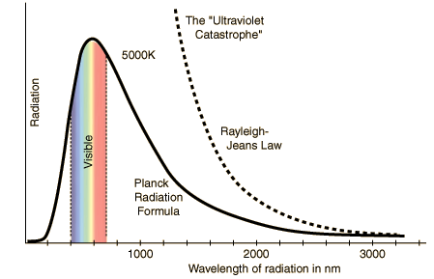
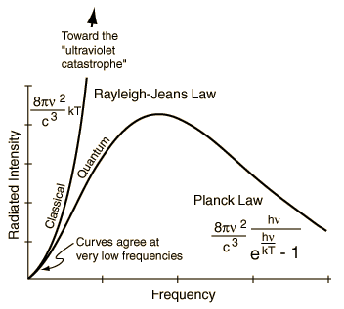
Black-Body Radiation
Classical viewpoint : Electromagnetic oscillators have been excited.
Quantization of energy : Permitted energies of the oscillator are integer multiples of hν
E = nhν
Rayleigh-Jeans Law
Planck Distribution

Slide 8
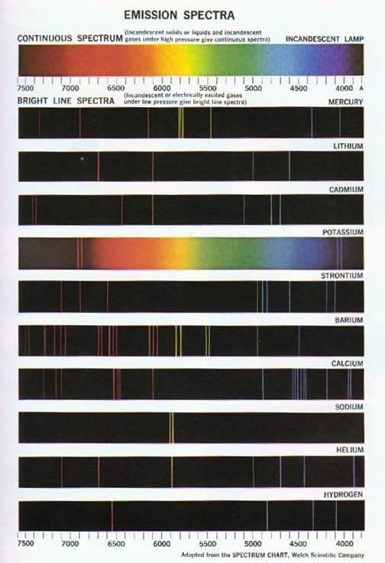
Line Spectra
Continuous & Discrete Spectra
The light emitted from luminous gases was found to consist of discrete colors which were different for different gases.
These spectral "lines" formed regular series and came to be interpreted as transitions between atomic energy levels.
No classical model could be found which would yield stable electron orbits.

Slide 9
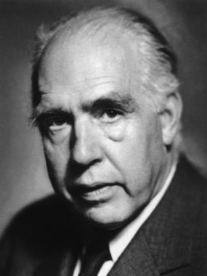
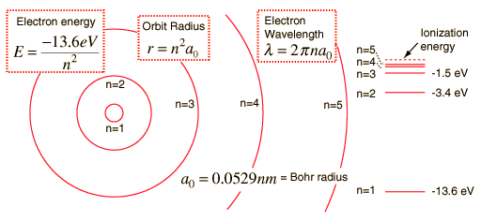
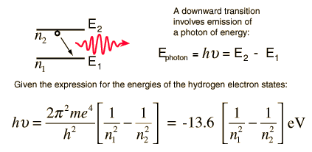
The Bohr Model of Atom
Niels Bohr
The orbiting electrons existed in orbits that had discrete quantized energies.
The laws of classical mechanics do not apply when electrons make the jump from one allowed orbit to another.
When an electron makes a jump from one orbit to another the energy difference is carried off (or supplied) by a single quantum of light (called a photon).
The allowed orbits depend on quantized (discrete) values of orbital angular momentum, L according to the equation

Slide 10
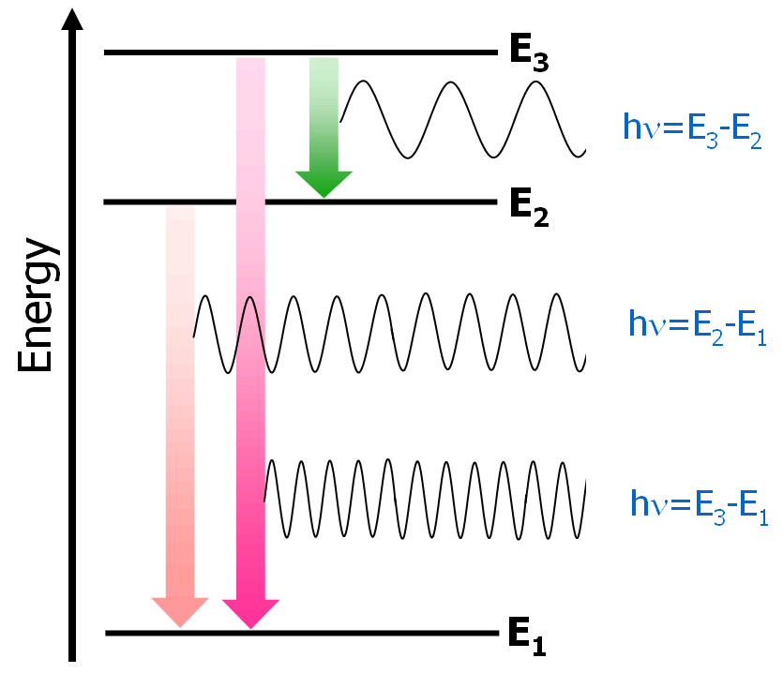
Line Spectra & Discrete Energy Levels
The Bohr model is able to explain the line spectra
The EM waves emitted from the heated atom are corresponding to their initial and final energy levels
Failures of the Bohr Model
The Bohr model fails to provide any understanding of why certain spectral lines are brighter than others.
The Bohr model treats the electron as if it were a miniature planet, with definite radius and momentum. This is in direct violation of the uncertainty principle which dictates that position and momentum cannot be simultaneously determined.
Definite orbits
n₁
n₂
n₃

Slide 11
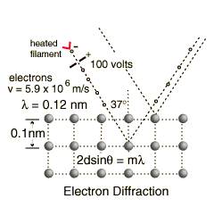
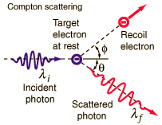
Wave-Particle Duality
The particle character of EM radiation
Photoelectron
Compton Scattering
The wave character of particles
Electron diffraction (Davidson-Germer Expt.)

Slide 12
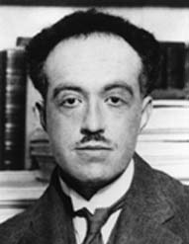
de Broglie Hypothesis
Louis de Brogile
De Broglie formulated the de Broglie hypothesis, claiming that all matter has a wave-like nature
Planck
Einstein
de Broglie relation
Dual property

Slide 13
Quantum Mechanics*
Electrons and other microscopic particles show wavelike as well as particle like behaviors.
The form of mechanics obeyed by microscopic system is called quantum mechanics (based on the idea of the quantization of energy).
The state of a system is defined by a mathematical function ψ
ψ is a function of coordinates and time;
ψ is generally a complex function;
* Werner Heisenberg, Max Born, Pascual Jordan

Slide 14
Mathematical Background
Complex number

Slide 15
Eigenvalue Problem
Eigenvalue Equation
Function φ is not changed when operated by an operator
Example
eigenfunction
Operator
eigenvalue (constant)

Slide 16
Wavefunction
Quantum mechanics acknowledges the wave-particle duality of matter by supposing that a particle is distributed through space like a wave (Wave Mechanics*).
Wavefunction is the function that contains all the measurable information about the particle
Wavefunction refers to any vector or function which describes the state of a physical system by expanding it in terms of other states of the same system.
The wavefunction must satisfy certain constraints:
Must be a solution of the Schrödinger Equation
Must be normalizable (must be quadratically integrable)
Must be a continuous function (must be single-valued)
The slope of the function must be continuous
* Other approaches are Matrix Mechanics (W. Heisenberg) and Transformation Theory (P.A.M. Dirac)

Slide 17
Wave Mechanics
Vibration of a string

Slide 18
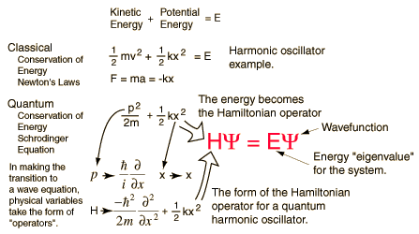
Schrödinger Equation
Erwin Schrödinger
Erwin Schrödinger proposed an equation for finding the wavefunction of any system.
Time-independent Schrödinger equation

Slide 19
Schrödinger Equation
Time Dependent Schrödinger Equation
If the wavefunction has a separable form;
Time Independent Schrödinger Equation

Slide 20
Schrödinger Equation
Time Independent Schrödinger Equation
1-dimension
3-dimension
Time Dependent Schrödinger Equation
Hamiltonian Operator

Slide 21
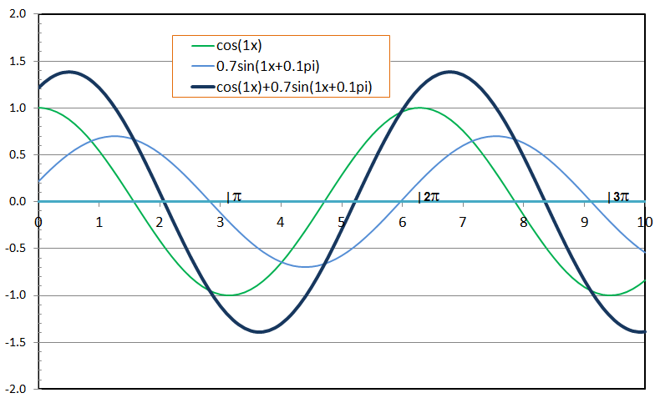
Solutions of Schrödinger Equation
If potential energy V is independent of x; V(x)=V
Constant=k²
momentum

Slide 22
The Information in a Wavefunction
The probability density
Eigenvalues and eigenfunctions
Operators
Superpositions and expectation values

Slide 23
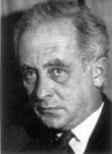
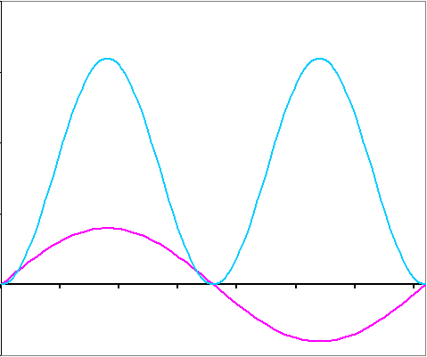
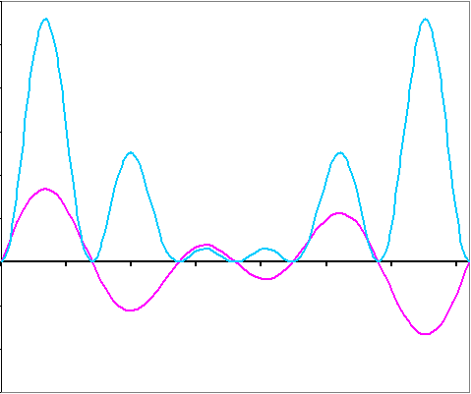
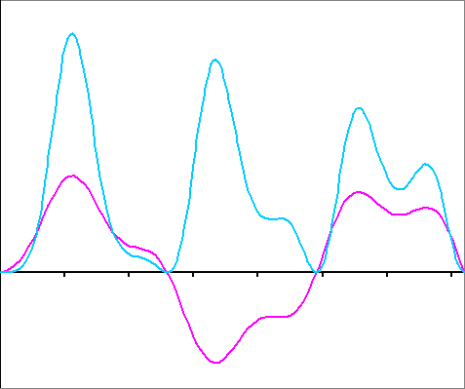
The Born Interpretation of the wavefunction
Max Born
The wavefunction contains all the dynamical information about the system it describes.
Born Interpretation: If the wavefunction of a particle has the value ψ at some point x, then the probability of finding the particle between x and x+dx is proportional to or
|ψ|²
|ψ|²
|ψ|²
ψ
ψ
ψ

Slide 24
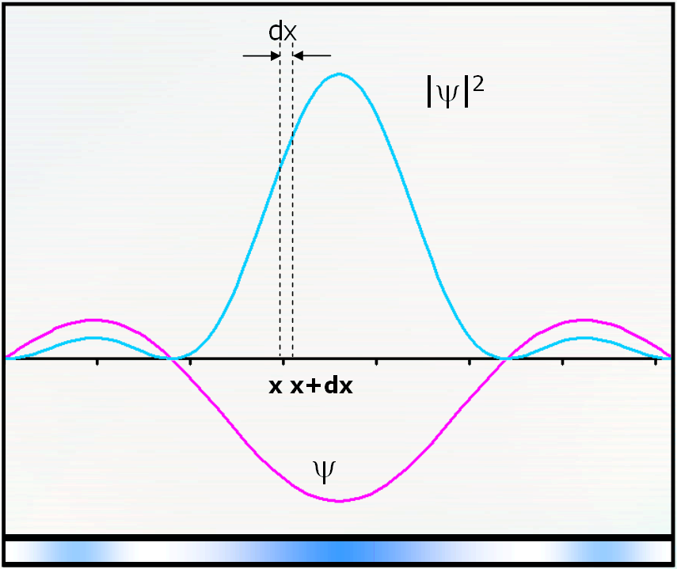
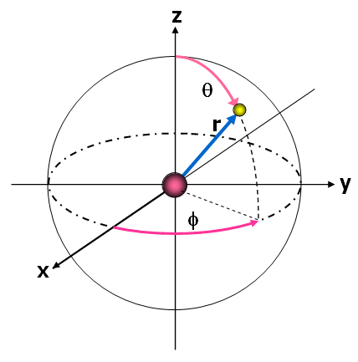
Probability of Finding the Particle
Probability of finding a particle between x and x+dx
Probability of finding a particle in overall space is 1
Normalized wave function
1-D:
3-D:

Slide 25
Spherical Coordinates
Coordinates defined by r, θ, φ *
z
θ
r
y
φ
x
1D:
2D:
3D:
www.mathworld.wolfram.com

Slide 26
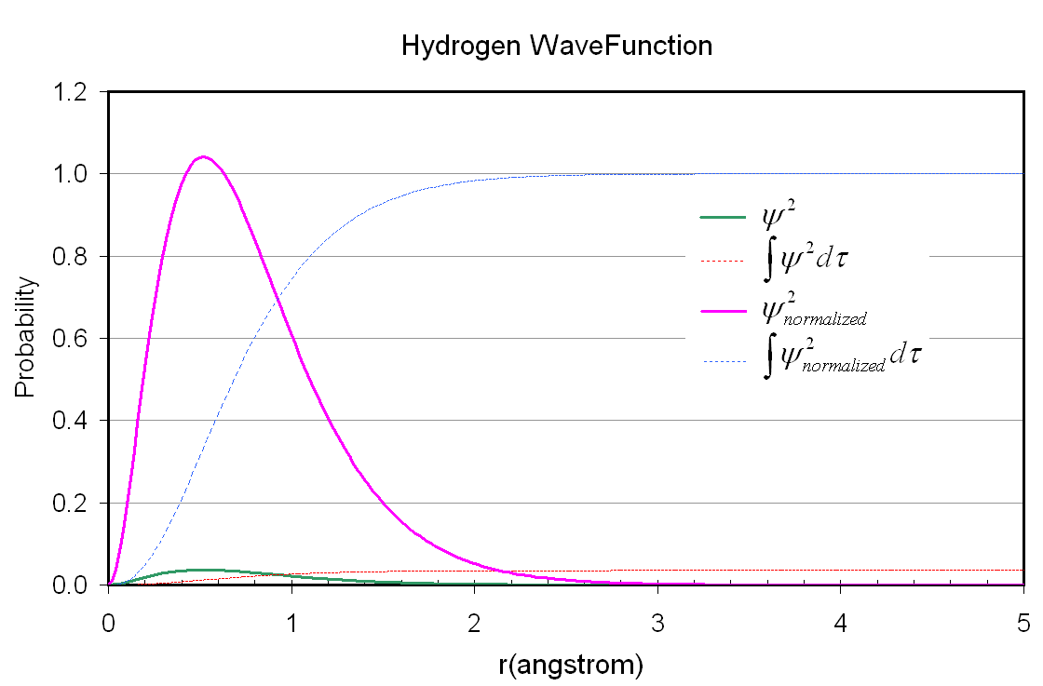
Normalized Wavefunction
Wavefunction* for an electron of the hydrogen atom

Slide 27
Eigenvalues and Eigenfunctions
The Schrödinger equation is a way to extract information from the wavefunction.
The general solution is where k is arbitrary depending on the condition of the system; boundary conditions (Eigenfunction)
H is an operator called Hamiltonian operator correponding to the total energy of the system
E is a quantity of the system corresponding to the H operator (Eigenvalue)
For other observables
operator X
observable X

Slide 28
Observable (Measurable) Operators
Hamiltonian Operator is the operator corresponding to the total energy of the system
Observables, , are presented by operators, , built from the following position and momentum operators:
If the wavefunction is not an eigenfunction of an operator, the property to which the operator corresponds does not have a definite value.

Slide 29
Hamiltonian operator
Linear operator
Laplace Operator (del square)

Slide 30
Superpositions
Observable quantity depends on the eigenfunction
The wavefunction can be written as a linear combination of eigenfunctions of an operator (superposition)
When the observable is measured in a single observation one of the eigenvalues corresponding to the eigenfunction that contribute will be found
The probability of measuring a particular eigenvalue in a series of observation is proportion to the square modulus of the corresponding coefficient in the combination

Slide 31
Complete Set & Orthogonality
According to the linear combination the function form a complete set if any wavefunction can be expressed as a linear combination of them.
Two functions, and , are orthogonal (independent on each other) if
Eigenfunctions corresponding to different eigenvalues of the same operator are orthogonal.

Slide 32
Expectation Values
The average value of a large number of observations is given by the expectation value, , of the operator corresponding to the observable of interest

Slide 33
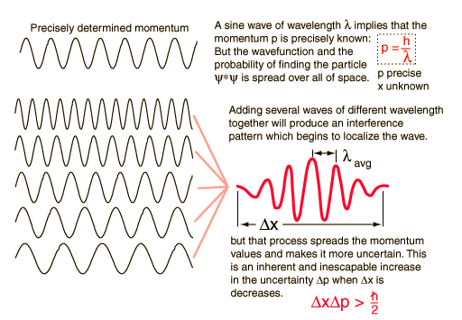
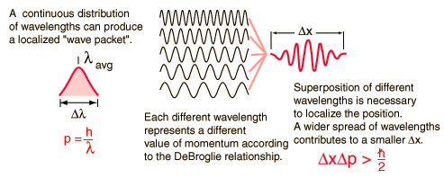
Uncertainty Principle
Werner Heisenberg
The Heisenberg uncertainty principle states that one cannot measure values (with arbitrary precision) of certain conjugate quantities, which are pairs of observables of a single elementary particle. These pairs include the position and momentum.

Slide 34
Key Ideas
Laws of Nature
Classical Mechanics (Failed in microscopic levels)
Quantum Mechanics
Wave-Particle Duality
Wavefunction:Wave Mechanics
Schrodinger equation
Eigen-equation
Time dependent/independent
Born interpretation
Acceptable wavefunctions
Information from wavefunctions
Measurable properties
Uncertainty principles

