Slide 1
Physical Chemistry III (728342) The Schrödinger Equation
Piti Treesukol
Kasetsart University
Kamphaeng Saen Campus
http://hyperphysics.phy-astr.gsu.edu/hbase/quacon.html#quacon

Slide 2
Solving Schrödinger Equations
Eigenvalue problem
Simple cases
The free particle
The particle in a box
The finite potential well
The particle in a ring
The particle in a spherically symmetric potential
The quantum harmonic oscillator
The hydrogen atom or hydrogen-like atom
The particle in a one-dimensional lattice (periodic potential)

Slide 3
Zero Potential
Zero potential everywhere
Wavefunction
The probability density
B=0
A=B

Slide 4
A Particle in a 1-D Box
A single microscopic particle moving in 1-D (x)
Particle is confined inside the 1-D box (0-a)
Region I & III
Region II
0 x a
∞ ∞
I II III
x
Trial function

Slide 5
Solutions for a Particle in a 1-D Box
Solve for possible r and s in that satisfy the Schrödinger equation.
Not all solutions are acceptable. The wave function needs to be continuous in all regions
x

Slide 6
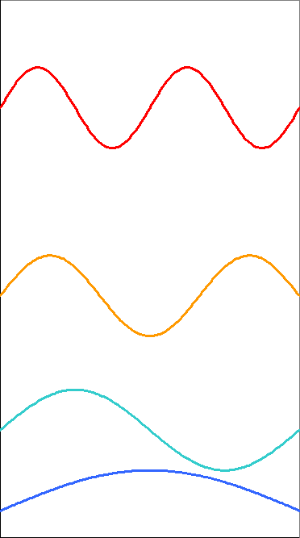
Solutions for a Particle in a 1-D Box
Using the boundary conditions
Only these allowed energy can make the wavefunction well-behaved.
E₄
n=4
E₃
Energy
n=3
E₂
n=2
E₁
n=1

Slide 7
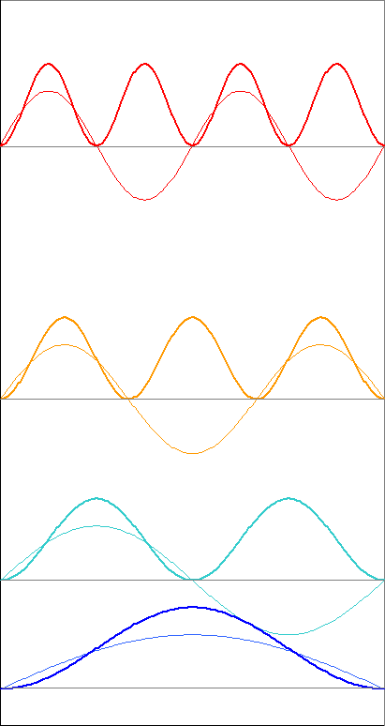
Solutions for a Particle in a 1-D Box
Normalizability of the wavefunction
The lowest energy is when n=1
For Macroscopic system, n is very large
Normalization constant
Zero-point energy
ground state

Slide 8
Solutions for a Particle in a 3-D Box
For the 3-D box (axbxc), the potential outside the box is infinity and is zero inside the box

Slide 9
Solutions for a Particle in a 3-D Box
Inside the box:
Outside the box:
Total energy
The ground state is when n_{x}=1 n_{y}=1 n_{z}=1

Slide 10
Degeneracy
A Particle in a 3-D box with a=b=c
States have the same energy.
An energy level corresponding to more than one states is said to be degenerate.
The number of different state belonging to the level is the degree of degeneracy.

Slide 11
Orthogonality and the Bracket Notation
Two wavefunctions are orthogonal if the integral of their product vanishes
Dirac Bracket Notation
bra
ket
Kronecker Delta

Slide 12
A Finite Depth Potential Box
A potential well with a finite depth
Classically
Particles with higher energy can get out of the box
Particles with lower energy is trapped inside the box
Energy
x

Slide 13
A Finite Depth Potential Box
If the potential energy does not rise to infinity at the wall and E < V, the wavefunction does not decay abruptly to zero at the wall
X < 0 V = 0
X > 0 V = constant
X > L V = 0
Barrier Height
Energy
Particle’s energy
x=0
x=L

Slide 14
The Tunneling Effect
Incident wave
Transmitted wave
Reflected wave
Energy
x=0
x=L

Slide 15
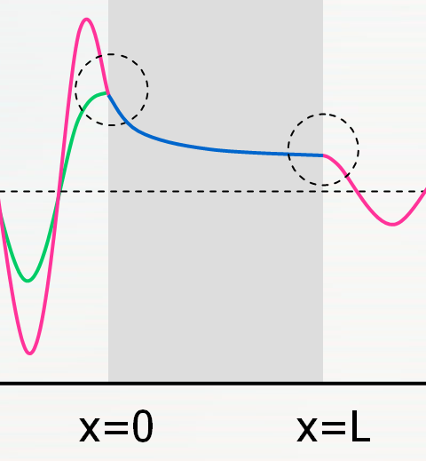
The Tunneling Effect
Boundary conditions (x=0, x=L)
F = 0 because there is no particle traveling to the left on the right of the barrier
Function
First Derivative
Function
First Derivative

Slide 16
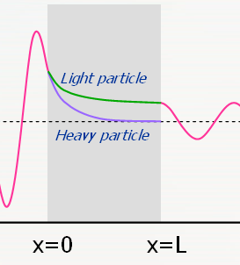
The Tunneling Effect
Transmission Probability
For high, wide barriers , the probability is simplified to
The transmission probability decrease exponentially with the thickness of the barrier and with m^{1/2}.
The leakage by penetration through classically forbidden zones is called tunneling.
1.0
0.5
0.0
Transmission Coefficient
0.0 1.0 2.0 3.0 4.0
E/V₀

Slide 17
The Harmonic Oscillator (Vibration)
A Harmonic Oscillator and Hooke’s Law
Harmonic motion: Force is proportional to its displacement: F= –kx when k is the force constant.
l
V
l₀
l
0
Equilibrium
x
Harmonic Potential

Slide 18
The 1-D Harmonic Oscillator
Symmetrical well
Schrödinger equation with harmonic potential:
7
6
5
Solving the equation by using boundary conditions that .
The permitted energy levels are
The zero-point energy of a harmonic oscillator is
Potential Energy, V
4
3
2
1
0
Displacement, x

Slide 19
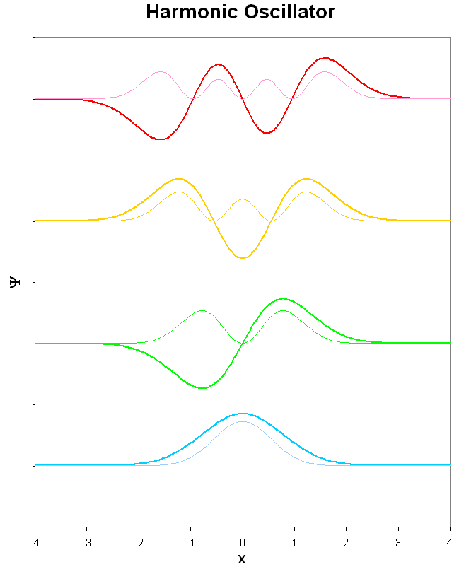
Solutions for 1-D Harmonic Oscillator
Wavefunctions for a harmonic oscillator
Hermite polynomials;

Slide 20
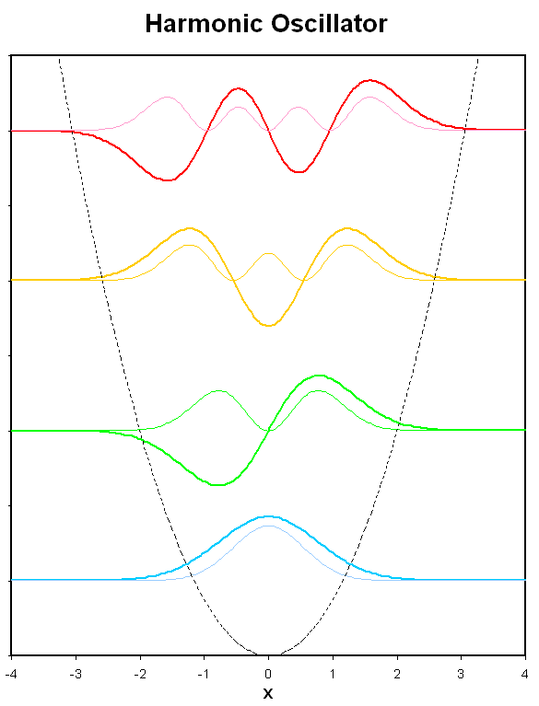
Wavefunctions
Normalizing Factors

Slide 21
At high quantum number (ν>>) harmonic oscillator has their highest amplitudes near the turning points of the classical motion (V=E)
The properties of oscillators
Observables
Mean displacement
n
7
6
5
4
3
2
1
0

Slide 22
Mean square displacement
Mean potential energy
Mean kinetic energy
The tunneling probability decreases quickly with increasing ν.
Macroscopic oscillators are in states with very high quantum number.
≈ 8%

Slide 23
Rigid Rotor (Rotation)
2-D Rotation
A particle of mass m constrained to move in a circular path of radius r in the xy plane.
E = E_{K}+V
V = 0
E_{K} = p²/2m
Angular momentum J_{z}= ±pr
Moment of inertia I = mr²
z
r
y
x
Not all the values of the angular momentum are permitted!

Slide 24
Using de Broglie relation, the angular momentum about the z-axis is
A particle is restricted to the circular path thus λ cannot take arbitrary value, otherwise it would violate the requirements for satisfied wavefunction.
Allowed wavelengths

Slide 25
The angular momentum is limited to the values
The possible energy levels are
m_{l} < 0
m_{l} > 0

Slide 26
Solutions for 2-D rotation
Hamiltonian of 2-D rotation
The radius of the path is fixed then
The Schrödinger equation is

Slide 27
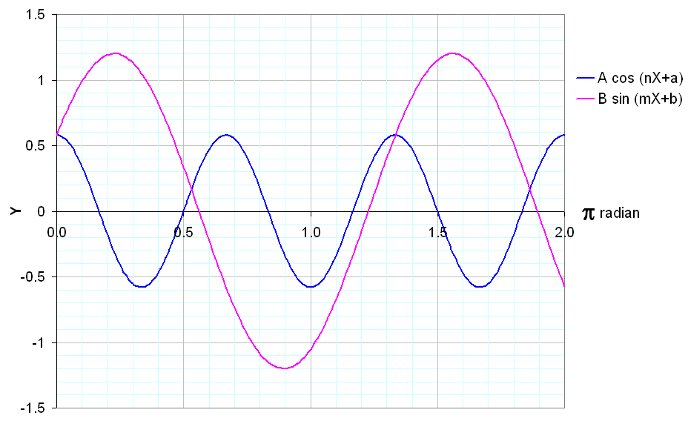
Cyclic boundary condition
The probability density is independent of φ

Slide 28
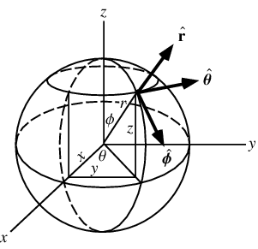
Spherical Coordinates
Coordinates defined by r, θ, φ *
www.mathworld.wolfram.com

Slide 29
3-D Rotation
A particle of mass m that free to move anywhere on the surface of a sphere radius r.
The Schrödinger equation
θ
φ
r

Slide 30
Using spherical coordinate
Discard terms that involve differentiation wrt. r
Legendrian

Slide 31
Plug the separable wavefunction into the Schrödinger equation
The equation can be separated into two equations

Slide 32
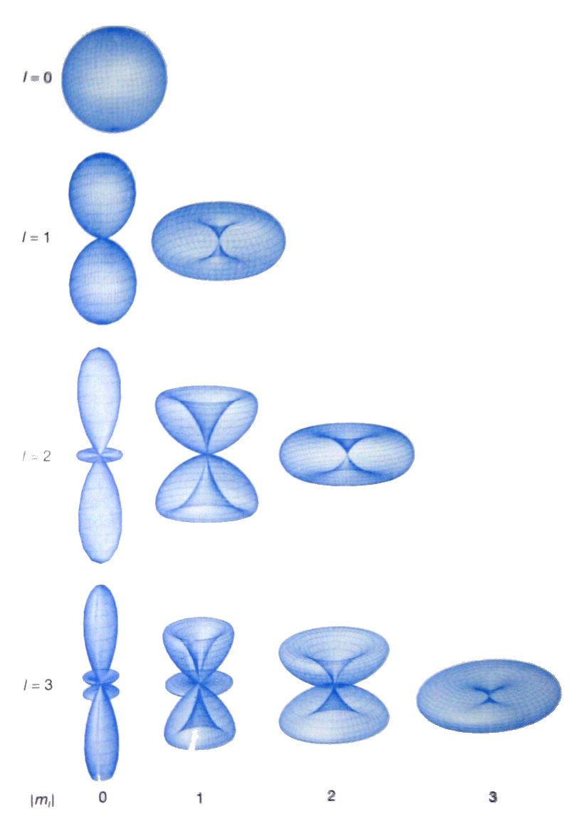
Solutions for 3-D Rotation
The normalized wavefunctions are denoted , which depend on two quantum numbers, l and m_{l}, and are called the spherical harmonics.
0 | 0
1 | 0
 | ±1
2 | 0
 | ±1
 | ±2

Slide 33
For a given l, the most probable location of the particle migrates towards the xy-plane as the value of |m_{l}| increases
The energy of the particle is restricted to the values
Energy is quantized.
Energy is independent of m_{l} values.
A level with quantum number l is (2l+1) degenerate.

Slide 34
Angular Momentum & Space Quantization
Magnitude of angular momentum
z-component of angular momentum
The orientation of a rotating body is quantized
m_{l} = +1
z
+2
+1
0
–1
–2
m_{l} = +2
m_{l} = 0
m_{l} = -2
m_{l} = -1

Slide 35
Spin
The intrinsic angular momentum is called “spin”
Spin quantum number; s = ½
Spin magnetic quantum number; m_{s} = s, s–1, … –s
Element particles may have different s values
half-integral spin: fermions (electron, proton)
integral spin: boson (photon)
m_{s} = +½
m_{s} = –½

Slide 36
Key Ideas
Wavefunction
Acceptable
Corresponding to boundary conditions
Modes of motion (Functions to explain the motion)
Translation → Particle in a box
Vibration → Harmonic oscillator
Rotation → Rigid rotor
Tunneling effect

