Slide 1
Physical Chemistry III (01403342)
Chapter 3: Atomic Structure
Piti Treesukol
Kasetsart University
Kamphaeng Saen Campus

Slide 2
Electronic Structures of Atoms
Hydrogenic atoms
Many-electron atoms
The orbital approximations
Self-consistent Field orbitals
Approximation Methods
  Variation Method
  Perturbation Method

Slide 3


Hydrogenic Atoms
A hydrogenic atom is a one-electron atom (H) or ion of general atomic number Z (He⁺, Li²⁺, etc.)
The coulombic potential energy
The Hamiltonian for the electron and a nucleus

Slide 4
The Hamiltonian for the internal motion of electron relative to the nucleus
Consider only the internal, relative coordinates
X_{e}
X
X_{N}

Slide 5
Hydrogenic Wavefunction
The wavefunction for hydrogenic atom is separable into radial and angular components.
multiply through by
constant
Spherical harmonics*
Radial Wave Equation

Slide 6
The Radial Solutions
The effective potential
The allowed energy
The radial wavefunctions are in form of
R(r) = (polynomial in r) x (decaying exponential in r)
Coulombic energy
Centrifugal energy
Associated Laguerre polynomial
Bohr radius = 52.9177 pm

Slide 7
Hydrogenic Radial Wavefunctions
orbital | n | l | R_{n,l}
1s | 1 | 0
2s | 2 | 0
2p | 2 | 1
3s | 3 | 0
3p | 3 | 1
3d | 3 | 2

Slide 8
The Radial Wavefunctions
The radial wavefunction of hydrogenic atoms (Z)
R/(Z/a₀)^{3/2}
R/(Z/a₀)^{3/2}
3s
R/(Z/a₀)^{3/2}
3p
1s
0 1 2 3
0 7.5 12 22.5
0 7.5 12 22.5
Zr/a₀
Zr/a₀
Zr/a₀
R/(Z/a₀)^{3/2}
R/(Z/a₀)^{3/2}
R/(Z/a₀)^{3/2}
3d
2s
2p
0 5 10 15
0 5 10 15
0 7.5 12 22.5
Zr/a₀
Zr/a₀
Zr/a₀

Slide 9
Example
A 1s-electron with n = 1, l = 0, m_{l} = 0
At r = 0
  The probability density
When Z=1

Slide 10
Atomic Orbitals and Their Energies
An atomic orbital (AO) is a one-electron wavefunction for an electron in an atom
Each hydrogenic AO is defined by n, l, and m_{l}
An electron described by is in the state and is said to occupy the orbital with n=1, l=0 and m_{l}=0
Electron in an orbital with quantum number n has an energy given by
  Different states with the same n are degenerate

Slide 11
The Energy Levels
The energy level of H atom
∞
Infinite separation (H⁺+e⁻)
3
Energy
2
Bound State : E is negative
Unbound State: E is positive
1
Rydberg Constant for H
Rydberg Constant

Slide 12
Ionization Energies
The ionization Energy, IE, is the minimum energy required to remove an electron from the ground state of one of its atoms.
Hydrogen atom, the ground state has n = 1
  Ionization energy of H atom is 2.179 x 10⁻¹⁸ J or 13.60 eV

Slide 13
Shells and Subshells
All the orbitals of a given value of n are said to form a single shell of the atom
  n = 1 2 3 4 …
  K L M N …
The orbital with the same value of n but different values of l are said to form a subshell of a given shell
  l = 0 1 2 3 4 5 …
  s p d f g h …
n
s p d f g h …
∞
4
3
Energy
[1] [3] [5]
2
[1] [3]
1
[1]

Slide 14
Curvatures and Energy
The hamiltonian operator
  The sharply curved function corresponds to a higher E_{K} (and a lower V) than the less sharply curved function
Hydrogenic atom
high E_{K}
high E_{K}
low E_{K}
low E_{K}
E
kinetic E
potential E
l ≠ 0
Effective Potential Energy
l = 0
Radius, R

Slide 15
Atomic Orbitals
s-orbital
  s orbital is spherically symmetrical
  The ground state of hydrogenic atom is electron in 1s orbital
  A radial node is where
  A probability density of electron is
  A simple way to show the boundary surface (high proportion of the electron probability; 90%)
R(r)
1s
3s
2s
radius

Slide 16
The Mean radius of an orbital
The mean radius of a 1s orbital
  The angular part is normalized
  The mean radius of an orbital is a function of r

Slide 17

Radial Distribution Functions
is the probability in finding electron in a region
Radial Distribution Function P(r) is the probability density at radius r of all direction
P(r)dr is the probability of finding electron in between the shell or radius r and r+dr
  For spherically symmetric orbital
  In General
r

Slide 18
The probability density
The radial distribution P(r) of 1s orbital
The most probable radius (r*)
The most probable radius of 1s
P/(Z/a₀)³
P(r)
ψ(r)²
r/a₀

Slide 19
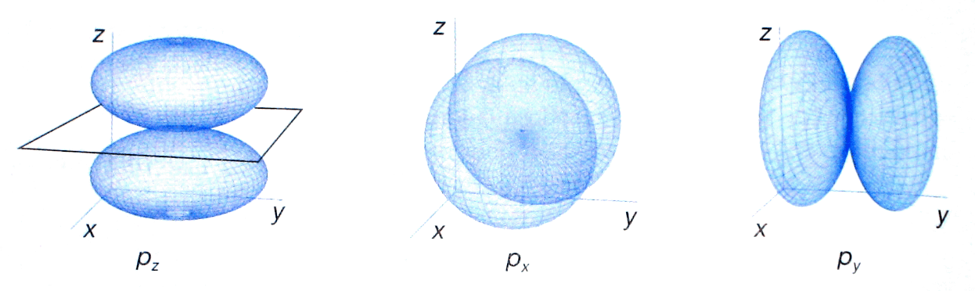
p orbitals
A p electron has nonzero orbital angular momentum
(l ≠ 0)
  p orbital has zero amplitude at r = 0
  The centrifugal effect (l >0) tend to put electron away from the nucleus

Slide 20
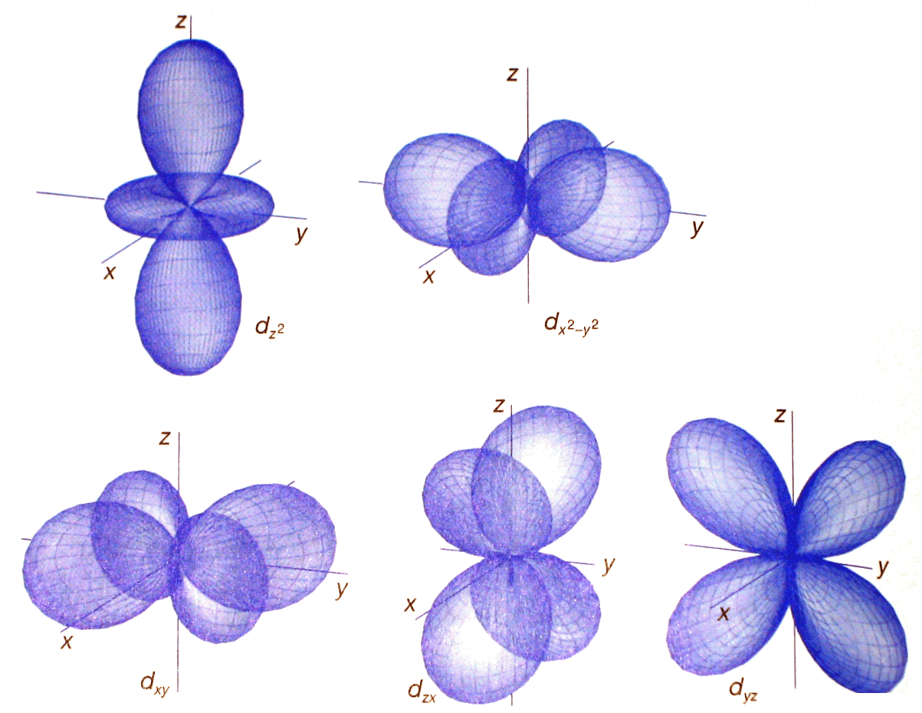
d-orbitals
d orbitals with opposite values of ml may be combined in pairs to give real standing waves

Slide 21
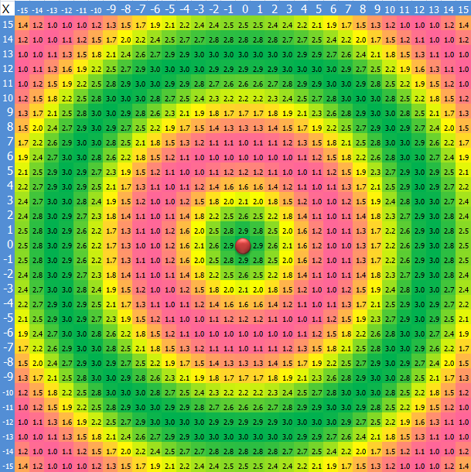

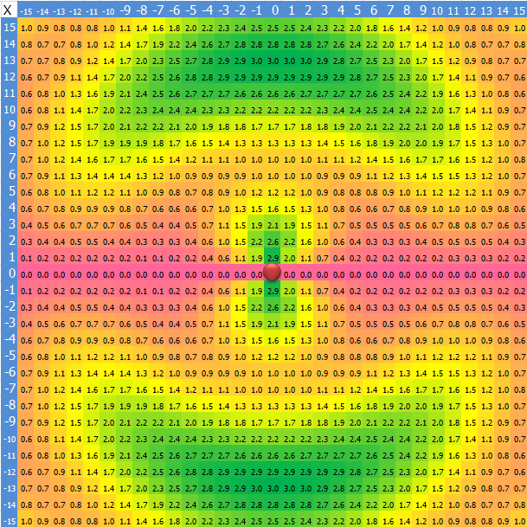
Radial function R(r)
Azimuth function Y(θ,φ)

Slide 22
Structures of many-electron atoms
The Schrödinger equation for many-electron atom is highly complicated
No analytical expression for the orbitals and energies can be given.
Several approximations are needed

Slide 23
The Orbital Approximation
Wavefunction of a many-electron atom is a function of coordinates of all the electrons where r_{i} is the vector from the nucleus to electron i.
The orbital approximation:
  The orbitals resemble the hydrogenic orbitals
  Each electron occupies its own orbital
  No interactions between electrons is accounted
1s(1)
2s(2)
2p_{z}(3)
2p_{x}(4)
ψ

Slide 24
The orbital approximation would be exact if there is no interactions between electrons.
  The hamiltonian of non-interacting 2-electron system
  Total energy is the sum of each electron’s energy

Slide 25
Many-Electron Atoms
The orbital approximation allows us to express the electronic structure of an atom by reporting its configuration
Electronic configuration: the list of occupied orbitals
He atom (Z=2)
  1st and 2nd electrons are in a 1s hydrogenic orbital
  The orbital is more compact than in H atom
The Pauli exclusion principle
No more than two electrons may occupy any given orbital and, if two do occupy one orbital, then their spins must be paired.

Slide 26
Pauli Principle
General statement
  When the labels of any two identical fermions are exchanged, the total wavefunction changes sign.
  When the labels of any two identical bosons are exchanged, the total wavefunction retains the same sign.
Total wavefunction = Spatial Wavefunction x Spin
Electrons are fermions

Slide 27
Consider possible spins for 2-electron system
  There are several possibilities for two spins
  Electrons are indistinguishable so if electrons have different spins, we cannot tell which electron is in which orbital
  The total-wavefunctions of the systems are

Slide 28
According to Pauli principle, the wavefunction is acceptable if it changes sign when the electrons are exchanged
The acceptable wavefunction for 2 electrons in the same spatial (ψ) orbital is
symmetric if both ψ are the same
symmetric
symmetric
symmetric
anti-symmetric

Slide 29
Electron exchange

Slide 30
Shielding
The subshell orbitals with the same n are not degenerate in many-electron system
Shielding Effect
Electron at a distance r from nucleus experiences a repulsion from other electron that can reduce the positive charge of the nucleus Z to Z_{eff} (the effective nuclear charge)
Element | Z | Orbital | Z_{eff}
He | 2 | 1s | 1.69
C | 6 | 1s | 5.67
 |  | 2s | 3.22
 |  | 2p | 3.14
+Z
No net effect of these electrons
Net effect equivalent to a point charge at the center
= shielding constant

Slide 31
Penetration
The shielding constant is different for s and p electrons because they have different radial distribution.
s-electrons has a greater penetration through inner shells than a p electron.
The energies of subshells in a many-electron atom in general lie in the order s < p < d < f
3p
3s
Radius Distribution function, P
radius

Slide 32
Li atom (Z=3)
  The first two electron occupy a 1s orbital
  The third electron cannot enter the 1s orbital (Pauli exclusion) and must occupy the next available orbital (n=2)
  According to the shielding effect, 2s and 2p are not degenerate and 2s orbital is lower in energy than the three 2p orbitals.
  The ground state configuration of Li is 1s² 2s¹
The electrons in the outermost shell of an atom in its ground state are called the valence electrons and others are called core electrons.

Slide 33
Aufbau Principle
Aufbau (building up) principle proposes an order of occupation of the hydrogenic orbitals that accounts for the ground-state configurations of neutral atoms
The occupation is
1s 2s 2p 3s 3p 4s 3d 4p 5s 4d 5p 6s …
  Each subshell consists of different number of orbitals
  Each orbital may accommodate up to 2 electrons
  This order is approximately the order of energies of the individual orbitals.
  The electron-electron repulsion could have an effect on this order.

Slide 34
Aufbau principle
  Electrons occupy different orbitals of a given subshell before doubly occupying any one of them.
    Electrons have a tendency to stay away from each others.
Hund’s maximum multiplicity rule
  An atom in its ground state adopts a configuration with the greatest number of unpaired electrons.
    Electrons with the same spin have electron correlation effect that make them stay well apart, which reducing the repulsion.

Slide 35
Suppose e₁ and e₂ are described by ψ_{a}(r₁) and ψ_{b}(r₂)
  Electrons are identical
  Pauli principle (asymmetry under particle interchange)
    if r₁ = r₂ (e₁ and e₂ are at the same point)
e– is specified by its position
→ needs asymmetric spin
→ needs symmetric spin
There is zero probability of finding 2 electrons at the same point in space when they have parallel spins.
Why?

Slide 36
Ne: 1S² 2S² 2P⁶ = [Ne] closed-shell
Na: 1S² 2S² 2P⁶ 3S¹ = [Ne] 3S¹
Ar: 1S² 2S² 2P⁶ 3S² 2P⁶ closed-shell (no e⁻ in 3d)
Sc – Zn (21-30)
  Energy of 3d is lower than 3s
  Sc: [Ar] 3d¹ 4s² (spectroscopy)
Energy
Energy
due to strong electrons repulsion
3d¹ 4s²
3d¹ 4s²

Slide 37
The Configurations of Ions
Cations
  Electrons are removed from the ground-state configuration of the neutral atom in a specific order.
  Electrons in the outer-most shell would be removed first.
    V = [Ar] 3d³ 4S² (23 e⁻)
    Sc = [Ar] 3d¹ 4S² (21 e⁻)
    V²⁺ = [Ar] 3d³ 4S⁰ (21 e⁻)
Anions
  Continuing the building up procedure and adding electrons to the neutral atom.
due to the different Z_{eff}s

Slide 38
Ionization Energies & Electron Affinities
1st Ionization Energy: the minimum energy necessary to remove an electron from a many-electron atom in the gas phase.
2nd Ionization Energy: the minimum energy necessary to remove a second electron from the singly charged cation.
The Electron Affinity: The energy released when an electron attaches to a gas-phase atom.

Slide 39
Electron-Electron Interactions
The potential energy of the electrons in many-electron atom is
The Hamiltonian of electrons
  Kinetic energy of a nucleus is omitted.
kinetic e-n attraction e-e repulsion

Slide 40
Self-Consistent Field Orbitals
The Hartree-Fock Self-Consistent Field (HF-SCF) Theory
  The wave function of many-electron system
  Focus on electron 1 and regard electrons
  2, 3 ,4 … as being smeared out to form a
  static distribution of electric charge (ρ)
    The potential energy of electron 1 due to electron 2
hydrogenic orbitals
3
r₃
r₂
2
r₁
1

Slide 41
Hartree-Fock Equation
The Hamiltonian for electron 1
The Schrödinger equation of electron 1
The total energy of n-electron system
coulomb integral

Slide 42
Hermitian Operator & Dirac Notation
Probability:
Eigen Value:
Overlap integral:
Schrödinger Equation:
Dirac notation
Hermitian operator

Slide 43
Slater Determinants
Consider the ground state of He atom (1s²)
Slater Determinant (anti-symmetric-satisfying wave f^{n}) the wave function can be written in the determinant form
  Ground state of He atom
  Ground state of Li atom (1s² 2s¹)
not satisfy antisymmetric requirement
α-spin β-spin

Slide 44
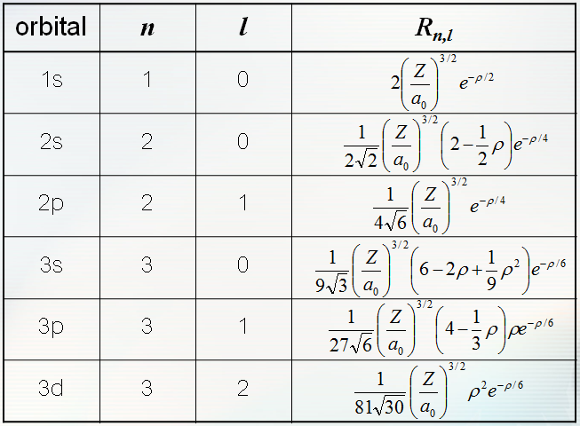
Variation Treatments of the Li Ground State
Applying the Variational method for the Li atom
  The ground state of Li atom
  The trial functions (wavef^{n} with shielding effect)
b₁ & b₂ are the variational parameters representing the effective nuclear charge for the 1s and 2s electron, respectively.

Slide 45
Variational Method
The Variational Theorem: if φ is normalized and satisfied all the conditions of the interested system then
  For any trial function φ
Variational theorem allows us to calculate an upper bound for the system’s ground state energy
energy of the ground state
Trial fn. Real fn.

Slide 46
Perturbation Theory*
The Hamiltonian of the complicated system can be considered as a sum of simple Hamiltonian with the perturbation
  Hamiltonian with Perturbation
Wave functions and energies can be expressed in a power series form
  Energy with the first-order correction (λ=1)

Slide 47


Slide 48
Key Ideas
Electronic structures
  Hydrogenic atoms (an electron with a positive charged ion)
  Many-electron atoms (interaction between electrons)
Hydrogenic atom
  Orbital wavefunctions
    Radial R(r) and Azimuth Y(θ,φ) functions
    Separation of variables
  Orbital Energies
  Radial distribution
Many-electron atom
  Orbital approximation
  Electronic configuration
    Pauli exclusion
    Hund’s maximum multiplicity
  Orbital Energies
  Self consistent field approx.

