Slide 1
Physical Chemistry III (728342) Chapter 4: Molecular Structure
Piti Treesukol
Kasetsart University
Kamphaeng Saen Campus
Updated: 13th Nov 2015

Slide 2
The Molecular Structure
Valence-Bond Theory
Shared electron pair
σ and π bonding
Hybridization
Molecular Orbital Theory
Linear Combination of Atomic Orbitals (LCAO)

Slide 3
The Born-Oppenheimer Approximation
Nuclei are much heavier than electrons so they move relatively slowly and may be treated as stationary while the electrons move in the nuclei-field.
Nuclei is fixed at arbitrary locations.
The Schrödinger equation for the wave function of electron alone is being solved.
Electrons adjust themselves to the optimum position around the nuclei.
Once the nuclei move, Electron readjust themselves instantaneously.
B
A
C

Slide 4
Molecular Potential Curve
Born-Oppenheimer Approximation
The Schrödinger equations for electrons at different nuclear separations can be solved.
Molecular Potential Curve: How the energy of the system varies with bond length (geometry)
No kinetic energy of the nuclei is accounted.
Electrons adjust themselves to the new configuration of the nuclei immediately.
0 Energy
R_{E}
R
D_{E}
A
B

Slide 5
Valence-Bond Theory
The valence-bond (VB) theory was the first quantum mechanical theory of bonding to be developed.
The essential feature of VB theory are the pairing of the electrons and the accumulation of electron density in the inter-nuclear region that stems form the paring.
Using general chemistry language
Spin pairing
Sigma and Pi bonds
Hybridization
+

Slide 6
The Hydrogen Molecule
The simplest molecule; H₂
The spatial wave function
electron 1 is on atom A and electron 2 is on atom B
electrons are indistinguishable so it’s not possible to know whether it’s electron 1 that is on atom A or electron 2.
the superposition of the wave functions
Lower energy
Ground state of H₂
Higher energy
Excited state of H₂

Slide 7
The formation of the bond in H₂ can be pictured as due to the high probability that the two electrons will be found between two nuclei and hence bind them together.
+
Two electrons from different atoms join the same orbital
The plot between the distance between two H atom and its wave function

Slide 8
Electron Spin
The total VB wave function for H₂ is
Using the Pauli principle, the total wave function needs to be asymmetric.
The spatial part is symmetric so the spin part needs to be asymmetric. The asymmetric spin for 2-electron system is

Slide 9
Homonuclear Diatomic Molecules
Diatomic molecule with the same atom types
N₂ (N: )
N
Z
N
2s
2p_{x} 2p_{y} 2p_{z}
+
+
nodal plane
σ bonding
π bonding

Slide 10
Polyatomic Molecules
Each sigma bond is formed by the spin pairing of electrons in atomic orbitals with cylindrical symmetry about the relevant internuclear axis.
Each pi bond is formed by paring electrons that occupy atomic orbitals of the appropriate symmetry.
Examples
H₂O
NH₃ ?
+
2

Slide 11
Promotion
An apparent deficiency of valence-bond theory is its inability to account for carbon’s tetravalence.
According to VB theory, carbon can form only 2 bonds.
This can be overcome by allowing for promotion, the excitation of an electron to an orbital of higher energy.
Now carbon atom is ready to form 4 bonds.
This promotion requires an investment energy which can be recovered from the bond formation.
This is not the “real” process.
The promotion energy for carbon is quite small (different energy between 2s and 2p)

Slide 12
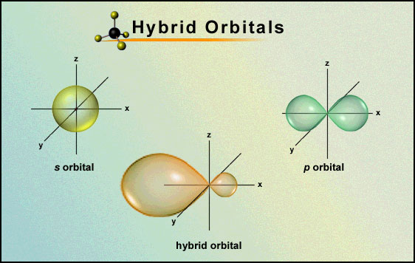
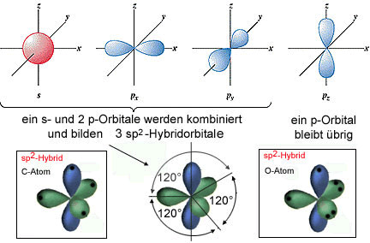
Hybridization
The description of the bonding in CH₄ is still not complete.
The electron density distribution in the promoted atom is equivalent to the electron density.
Each electron occupies a hybrid orbital formed by interference between the 2s and 2p orbitals.

Slide 13
+
¯
s
-s
p_{x}
s
p_{z}
-p_{z}
p_{x}
-p_{x}

Slide 14
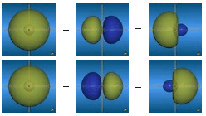
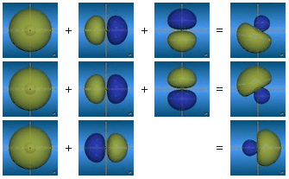
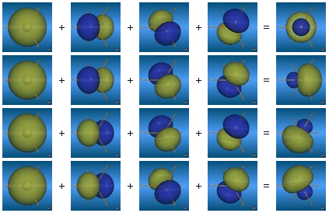
Linear Combination for Hybrid Orbitals
http://csi.chemie.tu-darmstadt.de/ak/immel/
sp hybridization
sp² hybridization
sp³ hybridization

Slide 15
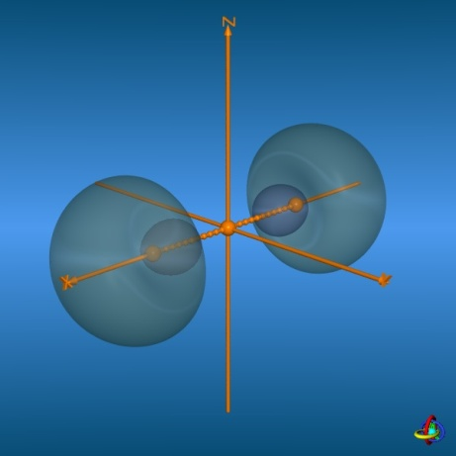
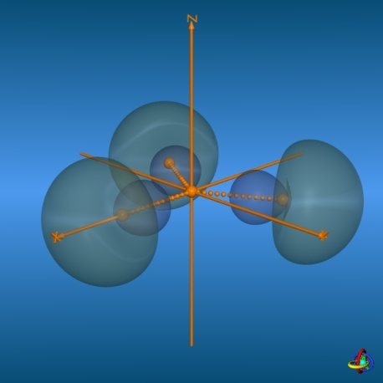
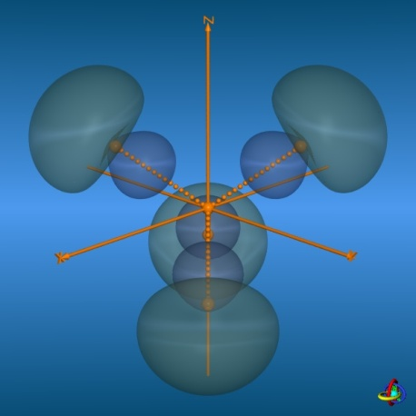
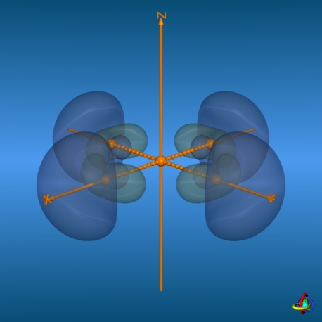
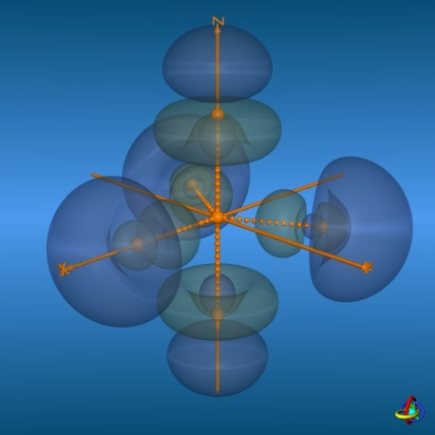
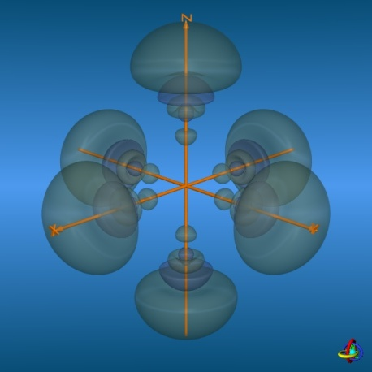
Directions of Hybrid Orbitals
sp sp² sp³
sp²d sp³d sp³d²

Slide 16
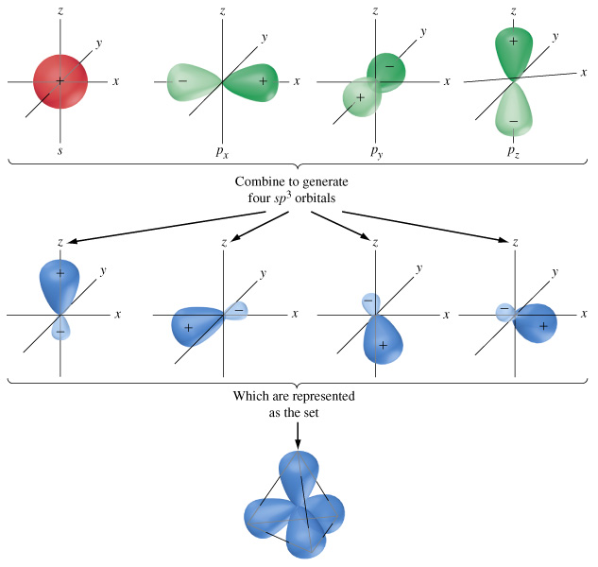
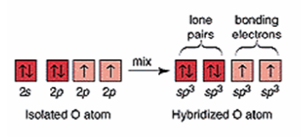
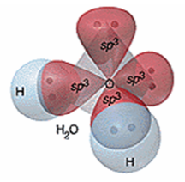
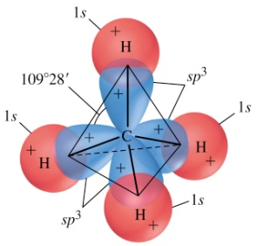
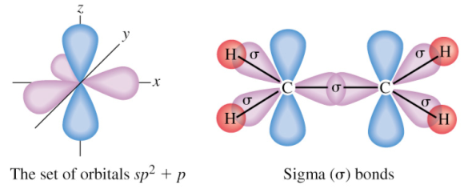
Bonding in VBT
H₂O
CH₄
C₂H₄

Slide 17
Molecular Orbital Theory
Basic Ideas
Electrons can spread throughout the entire molecule.
Electrons should not be regarded as belonging to particular bonds.
Electrons in a molecule can be described by their wave function or specified by their orbitals.
The Molecular Orbital can be derived from
Atomic orbitals
Schrödinger equation
A molecular orbital is like an atomic orbital but it spreads throughout the molecule.

Slide 18
The Hydrogen-Molecule Ion
The simplest molecule with one electron is H₂⁺
The Hamiltonian for the single electron in H₂⁺ is where r_{A1} and r_{B1} are the distances of the electron (1) from the two nuclei (A and B) and R is the distance between the two nuclei.
The one-electron wave functions obtained by solving the Schrödinger equation are called molecular orbitals (MO).
r_{A1}
r_{B1}
R

Slide 19
Linear Combinations of Atomic Orbitals
The wave function of electrons in a molecule is a superposition of the comprising atomic orbitals.
The molecular orbitals (MO) can be written as the linear combinations of atomic orbitals (AO).
An approximate molecular orbital formed from a linear combination of atomic orbitals is called an LCAO-MO.

Slide 20
Bonding Orbitals
If the molecular orbital is the probability density corresponding to the wave function ψ₊
A² and B² are the probabilities if the electron were confined to the atomic orbitals A and B
2AB is the overlap density
The overlap density represents an enhancement of the probability of finding the electron in the internucler region.
The enhancement is the result of the constructive interference of the two atomic orbitals

Slide 21
Antibonding Orbitals
The linear combination ψ₋ corresponds to a higher energy than ψ₊.
The probability density of ψ₋ is
There is a reduction in probability density between the nuclei due to the -2AB term which is destructive interference where the two atomic orbitals overlap.
The antibonding electron is excluded from the internuclear region and it can pulls the nuclei apart.

Slide 22
Types of Bonding
Sigma bonding (σ)
Sigma antibonding (σ*)
Pi bonding (π)
Pi antibonding (π*)
A
+
B
A B
A
+
B
A B
A
+
B
A B
A
+
B
A B

Slide 23
The Electronic Structure of Diatomic Molecules
Using the building-up principle to deduce the ground electronic configurations
Construct molecular orbitals by combining the available atomic orbitals.
Accommodate the electrons supplied by the atoms in the molecular orbitals to achieve the lowest energy.
Pauli exclusion principle
Hund’s maximum multiplicity rule

Slide 24
The Hydrogen and Helium Molecules
H₂
He₂ He₂ has one bond and one antibond. An antibond is slightly more antibonding than a bond is bonding. The He₂ molecule has a higher energy than the separated atoms so it is unstable relatively to the individual atoms
H₂ 2σ*
H 1s
H 1s
H₂ 1σ
He₂ 2σ*
He 1s
He 1s
He₂ 1σ

Slide 25
Bond Order
A measure of the net bonding in a diatomic molecule is its bond order, b;
n= number of electrons in bonding orbitals
n= number of electrons in antibonding orbitals
The greater the bond order, the shorter the bond
The greater the bond order, the greater the bond strength

Slide 26
Period 2 Diatomic Molecules
General form of the sigma orbitals
From the four atomic orbitals we can form four molecular orbitals of sigma symmetry by an appropriate choice of the coefficients c.
Four orbitals can be separated into two sets according to their energy levels

Slide 27
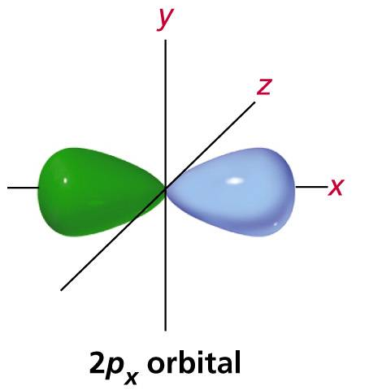
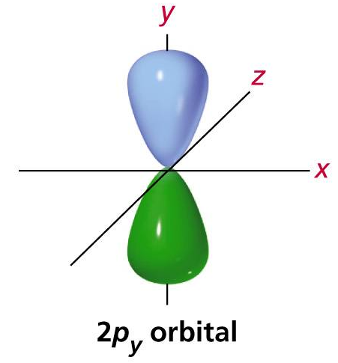
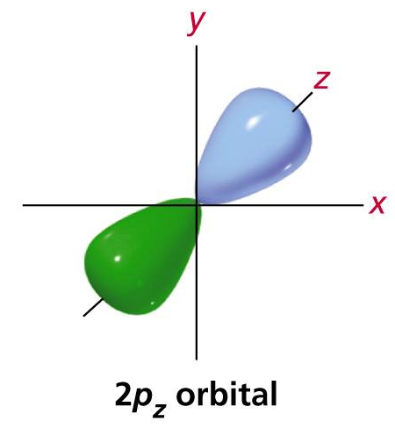
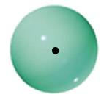
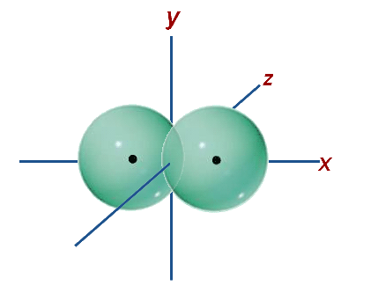
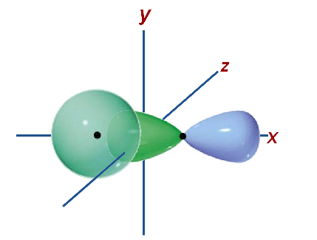
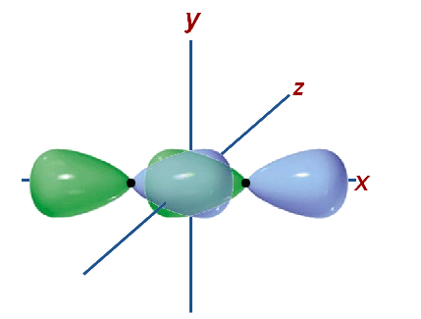
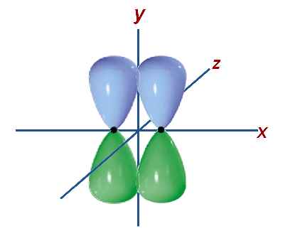
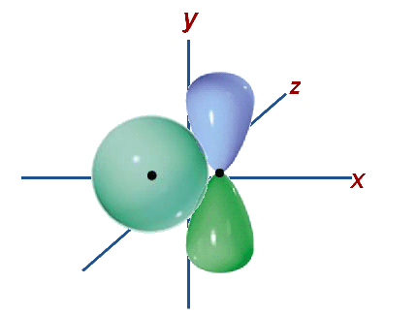
LCAO-MO
The forming of the LCAO-MO depends on
Energy level of the atomic orbitals
Symmetry of the atomic orbitals
y
z
x
2s orbital

Slide 28
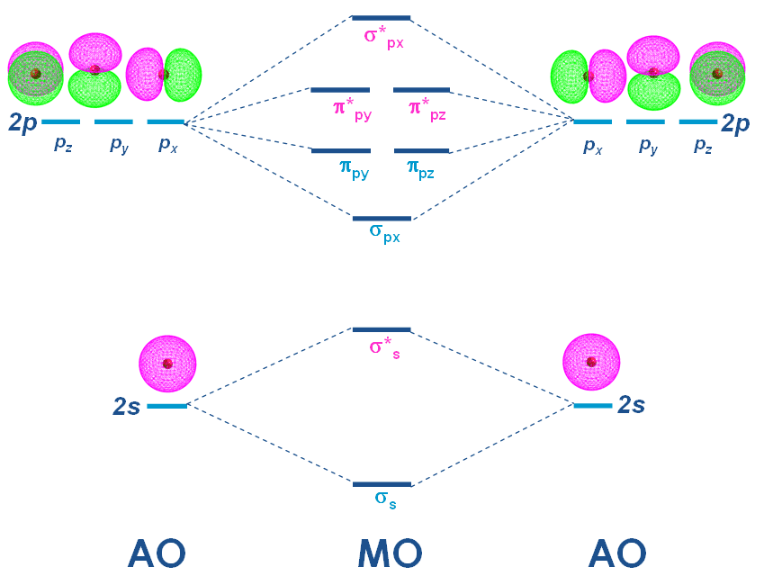
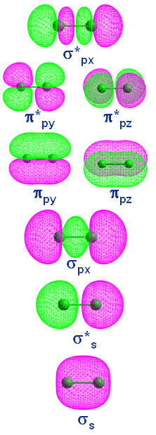
Molecular Orbital Diagram
E-configuration: (σ_{2s})²(σ_{2s}*)² (σ_{2px})² (π_{2p})⁴(π _{2p}*)⁴(σ_{2px}*)²
E n e r g y

Slide 29
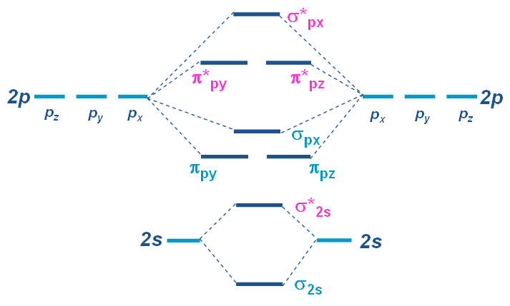
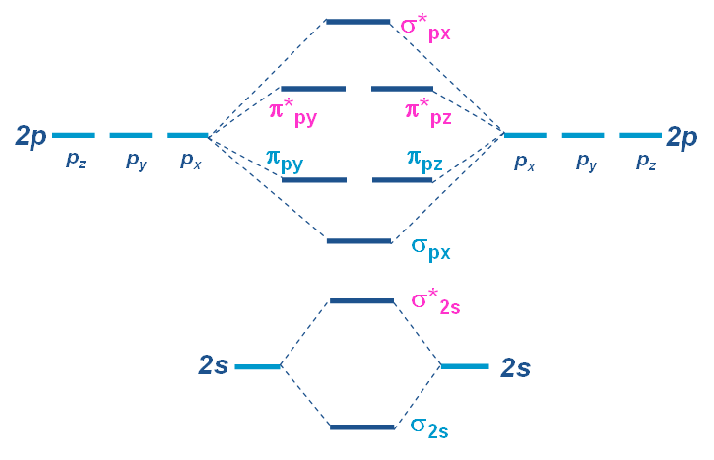
MO Diagram of Diatomic Molecules
N₂ (2 x 5 valence electrons)
N = 1s² 2s² 2p³
Bond order = 3
Similar to C₂ and B₂’s diagrams
O₂ (2 x 6 valence electrons)
O = 1s² 2s² 2p⁴
Bond order = 2
E n e r g y
MO of N₂
(σ_{2s})²(σ_{2s}*)² (π_{2p})⁴(σ_{2px})²
MO of O₂
(σ_{2s})²(σ_{2s}*)²(σ_{2px})²(π_{2p})⁴(π_{2p}*)²

Slide 30
Overlap Integral
Overlap integral, S, is the extent to which two atomic orbitals on different atoms overlap.
S is small if two orbitals are on atoms that are far apart.
If ψ_{A} and ψ_{B} are simultaneously large in the same region, then S may be large.
If the two normalized atomic orbitals are identical then S = 1.
1
0.8
0.6
0.4
0.2
0
A B
A B
small overlapping
large overlapping
S
0 2 4 6
R/a₀
The overlap integral between two H1s orbitals as a function of their separation.

Slide 31
Heteronuclear Diatomic Molecules
Heteronuclear diatomic molecule is a diatomic molecule formed from atoms of two different elements
The electron distribution in the covalent bond between the atoms is not evenly shared.
Polar bond: a covalent bond in which the electron pair is shared unequally by the two atoms.
H + H
σ*
H + F
σ*
H-1s
H1s_{A}
H1s_{B}
δ⁺
δ⁻
H H
σ
H F
σ
F-2p
Homonuclear Diatom
Heteronuclear Diatom

Slide 32
Bondings
A bond consists of two electrons in an orbital of the form
c_{i} is the coefficent of the wave function ψ_{i}.
The proportions of the atomic orbitals A and B in the bond are |c_{A}|² and |c_{B}|², respectively.
Non polar bond: |c_{A}|² = |c_{B}|²
Polar bond: |c_{A}|² ≠ |c_{B}|²
Ionic bond: |c_{i}|² = 0 (i = A or B)

Slide 33
Polar Bonding
A bond with |c_{A}|² ≠ |c_{B}|²
The atomic orbital with the lower energy makes the large contribution to the bonding molecular orbital.
One with the higher energy makes the large contribution to the antibonding molecular orbital.
Electrons prefer residing on the lower-energy orbitals and this controls the electron distribution of the molecule.
The atomic orbital energy levels of H and F atoms and the molecular orbitals of HF molecule.
σ*
13.4 eV
13.6 eV
H1s
18.6 eV
18.8 eV
σ
F2p

Slide 34
The Variational Principle
The coefficients in the linear combinations used to build molecular orbitals can be provided by the variation principle.
The Variational Priniciple: If an arbitrary wave function (trial wave function) is used to calculate the energy, the value calculated is never less than the true energy.
The best coefficients in the trial wave function will provide the lowest energy but the lower energy can be achieved by using a more complicated trail wave function.
Trial/Basis functions
trial wave functions
coefficients

Slide 35
The energy of an molecule can be determined from its wave function:
The trial wave function Φ is not normalized because its coefficients (ci) are arbitrary at this stage thus the energy is in the form of
Using the variation principle, we search for the coefficients that minimize the value of the energy

Slide 37
The energy can be determined from when
We want to solve for the coefficients that minimize the energy E.
coulomb integral
resonance integral
overlap integral

Slide 38
Molecular Orbitals for Polyatomic Systems
The molecular orbtials of polyatomic molecules are built in the same way: when is an atomic orbital and the sum extends overall orbitals of all the atoms in the molecule.
Using the variation principle with trial wave functions
A complete set of φ_{i} is call the basis set (a set of AO’s)
The coefficients can be solved in the same way but is more complicate.

Slide 39
Examples of LCAO-MO
H₂O
H 1s (x2)
O 1s 2s 2p_{x} 2p_{y} 2p_{z}
Number of MO’s equals to number of AO’s

Slide 40
Schrödinger equation multiply by φ_{i} and integrate over all space,
There are n equations (for i = 1 to n with different φ_{i}).
A MO is represented by LCAO of n basis function

Slide 41
For system with 2 basis functions (A,B)
For i=A
For i=B There are 2 variables to be solved (c_{A}, c_{B}) therefore we need two equations.

Slide 42
The Matrix Formulation
For a two-atom system (with 2 basis functions, A and B), the secular equations have the form
Using the Matrix notation

Slide 44
For a 3-basis function system (A,B,C)
We needs three equations to solve for c_{A}, c_{B}, and c_{C}
We need to solve these equations simultaneous!

Slide 45
If there are N orbitals in the basis set, then there are N eigenvalues (E) and N corresponding column vectors.
There would be N secular equations to be solved.
N equations can be written in the matrix form by introducing the matrices and the entire set of equation can be expressed as

Slide 46
If we use an orthogonal basis set; we can neglect the matrix S (it can be either 1 or 0), then
The eigenvalue E can be solved by

Slide 47
Schrödinger equation for MO
for each MO
for all MOs
Matrix S is neglected where S_{ii} = 1 and S_{ij} = 0

Slide 48
Secular Equation for Diatomic Molecules
Consider the molecular orbital built from two AOs
The coefficients are given by the solutions of the two secular equations
The secular equations have a solution if the secular determinant is zero:
For homonuclear molecule

Slide 49
Homoatomic Molecule
For homoatomic molecule
α and β are negative
The lower energy corresponds to the bonding orbital
The higher energy corresponds to the antibonding orbital
The bonding and antibonding wave functions are

Slide 50
Heteroatomic Molecule
For heteroatomic molecule
If we approximate that S=0 (a simple case)
The lower energy corresponds to the bonding orbital
The higher energy corresponds to the antibonding orbital and
If the difference between α_{A} and α_{B} are large the energies of the MO orbitals differ slightly from those of the atomic orbitals (low mixing).

Slide 51
The Hückel Approximation
Consider conjugated molecules (Alternation of single and double bonds)
Pi orbitals are treated separately from the sigma orbitals.
Consider sigma bonds to be fixed and concentrate on finding the energies of the pi bonds and antibonds.
The Pi molecular orbital energy level diagrams of conjugated molecules can be constructed using a set of approximations suggested by Erich Hückel.
All overlap integrals (S) are set equal to zero.
All resonance integrals (β) between non-neighbors are set equal to zero.
All remaining resonance integrals are set equal.
Restricted to planar conjugated hydrocarbons
β₁₂ = β₂₃ = β₃₄ = β₄₅ = β₅₆ = β
2
4
6
3
5
β₁₃ = β₁₄ = β₁₅ = β₁₆ = β₂₄ … = 0
1

Slide 52
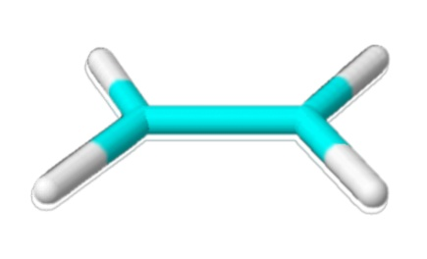
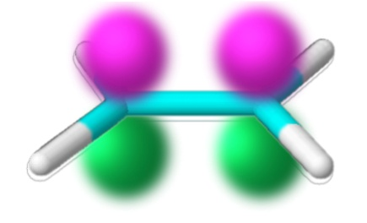
Ethene – Hückel Approx.
The Pi orbitals of ethene can be expressed by as LCAOs of the C-2p orbitals.
ψ_{A} and ψ_{B} are the C-2p orbitals on atoms A and B.
Using the variational principle (α_{A}= α_{B} = α)
Using Hückel approximation

Slide 53
Two possible energy levels are corresponding to the bonding (+β) and antibonding (-β).
The ground state configuration is 1π2.
The excitation energy from 1π to 2π* is 2β.
Frontier orbitals
HOMO: The highest occupied molecular orbital
LUMO: The lowest unoccupied molecular orbital
2π*
α-β
C2p_{A}
C2p_{B}
1π
α+β

Slide 54
Butadiene – Hückel Approx.
The Hückel approximation for butadiene
B
D
A
C

Slide 55
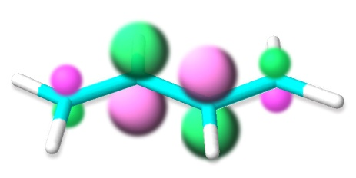
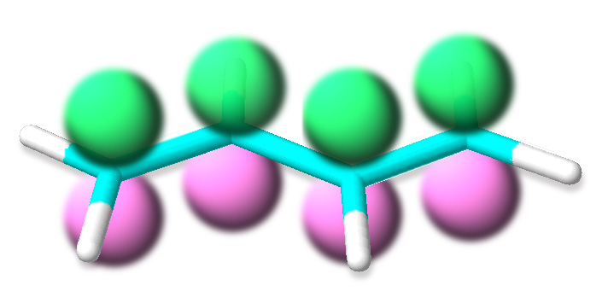
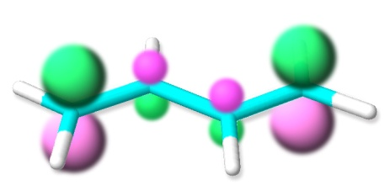
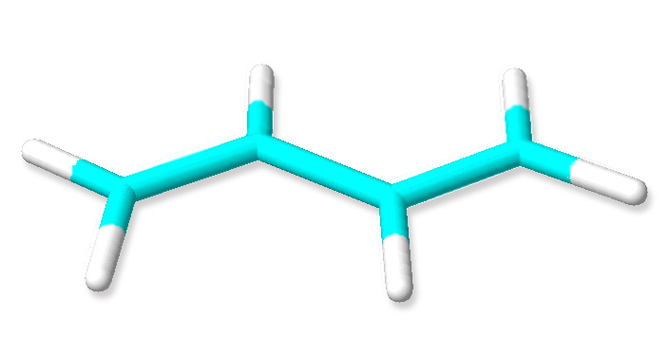
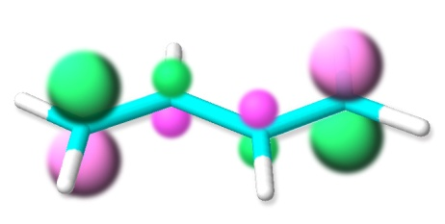
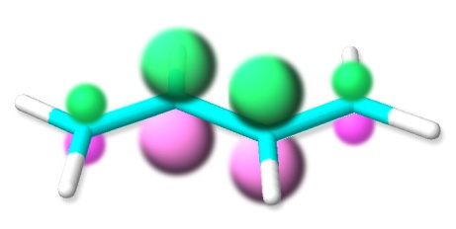
Pi-MOs of butadiene
4π*
3π*
2π
1π
Excitation energy:

Slide 56
Delocalization Energy and Stability
π-electron binding energy: The sum of the energies of each π electron.
Ethene (1 π-bond)
Energy levels
π-electron binding energy
Butadiene (2 π-bonds)
Energy levels
π-electron binding energy
The energy of the butadiene molecule is 0.48β more stable than the sum of two individual π bonds.
Comparison between the π-electron binding energies of ethene and butadiene shows the extra stabilization of a conjugated system called the delocalization energy.

Slide 57
Benzene – Aromatic Stability
Benzene
1
2
b_{2u}
e_{2u}
6
3
e_{1g}
5
4
a_{2u}
b_{2u}
e_{2u}
e_{2u}
The π-bond formation energy: 8β
The delocalization energy: 2β
a_{2u}
e_{1g}
e_{1g}

Slide 58
Extended Hückel Theory
The Hückel theory has been modified to make it applicable to more sophisticate molecules.
Include both σ and π orbitals
Calculate overlap integrals and store them as a matrix S; for example
Set the α terms to the negative of ionization energies of each orbital
Set the β terms to the values calculated from
The Schrödinger equation can be solved by
An overlap between H1s orbitals
K is a constant (equal to 1.75)

Slide 59
H₃⁺
Using the extended Hückel theory with H₃⁺
The overlap integral matrix is
The Hamiltonian matrix is
The eigenvalues are 0.679α, 0.679α, and 1.281α.
The eigenvector matrix is
An example of the molecular orbitals (non-normalized)
H
H
H
c_{ij}s are not normalized.

Slide 60
Mulliken Population Analysis
Consider a two-atom molecular orbital
The probability density for an electron that occupies this orbital is
The total probability is and the atomic population (ρ_{i}) and the overlap population (ρ_{ij}) are defined as
In general cases, one-half of the sum of overlap populations is the gross orbital population.

Slide 61
Self-Consistent Field Calculations

Slide 62
Hartree Method
The wave function of n-electron system can be approximated as a product of n hydrogenic orbitals (trial wave function with adjustable parameters), called a Hartree product.
The Hartree Equation
Each orbital is solved iteratively by using the Variational principle to get a better wave function ( ).
Total Energy
Each orbital can accommodate up to 2 electrons.
many-electron atom
Kinetic energy
Potential energy
(in the electrostatic field from other particles)
Orbital energy
Coulomb integral

Slide 63
Slater Determinants
Slater Determinant of an atomic orbital
The many-electron wave function is a product of one-electron wave functions (spin orbitals):
This wave function doesn’t satisfy the Pauli principle!
The acceptable form of the wave function can be written in a matrix’s determinant form (Slater determinant).
Anti-symmetrized spin-orbitals
A compact form:

Slide 64
Slate determinant of He
Slater determinant of Li
These wave functions satisfies the Pauli principle.

Slide 65
The Hartree-Fock Method
The wave function can be written in the Slater determinant form of each orbital.
Each of the electron wave function must satisfy the Hartree-Fock equations:
Fock operator:
Core Hamiltonian:
Coulomb operator, J:
Exchange operator, K:
A compact form:
An exchange term is a result from electron-interchanging (the use of Slater determinant).

Slide 66
The Roothaan Equations
Express the wave function as a linear combination of a basis function ( )in the Hartree-Fock method
Multiply from the left by and integrate over the coordinates of electron 1
The Roothaan equations (in Matrix form)

Slide 67
Basis Functions
Basis functions: a complete set of known functions.
Any functions of interest can be represented by a linear combination of basis functions.
A simplest set of basis functions is a set of occupied AO wave function.
H → H-1s
He → He-1s
C → C-1s C-2s C-2p_{x} C-2p_{y} C-2p_{z}
etc.
Unoccupied orbitals may be required to create MOs
A larger set of basis functions is generally used to make the orbital more realistic, for example:
H → H-1s, H-2s, H-2p_{x}, H-2p_{y}, H-2p_{z}
H
+
H

Slide 68
Semi-empirical & ab initio Methods
To solve the Schrödinger equation, a large number of integrals need to be calculated.
ab initio Method: all integrals are calculated
Semi-empirical Method: many of the integrals are estimated by appealing to experimental data and some are neglected.

Slide 69
Density Functional theory
If the system comprises of n electrons, the wave function is a function of 3n parameters. Solving the equation is painful work.
DFT proposes that the energy of the system is a function of electron density, which is a function of 3 parameters. Thus the electron density can be used, instead of the wave functions, to represent the system.
The density can be calculated by and the wave function can be solved from Kohn-Sham equation.
The wave function is iteratively solved to get the best electron density.

Slide 70
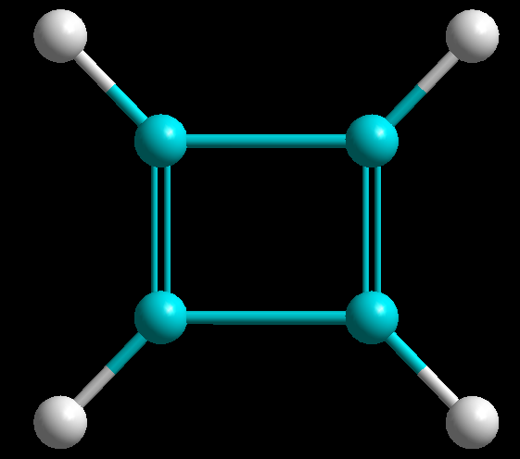
1
2
3
4

