Slide 1
Physical Chemistry III
01403343
Statistical Mechanics
Piti Treesukol
Chemistry Department
Faculty of Liberal Arts and Science
Kasetsart University : Kamphaeng Saen Campus

Slide 2
มโน เนติ สสาร
MIND MOVES MATTERS
จิตเคลื่อนสสาร
– ด้วยความคิดของเรา ทุกสิ่งทุกอย่างย่อมเป็นไปได้

Slide 3
ประกาศ
สอบกลางภาค 22 มีนาคม 2557 13:00-16:00 น.
สอบปลายภาค 22 พฤษภาคม 2557 13:00-16:00 น.

Slide 4
Introduction
Macroscopic picture
  Bulk material
  Thermodynamic & Kinetic properties
Microscopic picture
  Atom, Molecule, Ion
  Position, Energy, Momentum
Link between micro- and macro pictures
  Statistical method

Slide 5
คำถาม (1)
  ระบบที่สนใจคืออะไร
  ระบบคืออะไร
  สภาวะของระบบ
  การเปลี่ยนแปลงของระบบ
  ระบบที่เสถียรจะต้องเป็นอย่าง
  ความเสถียรคืออะไร
  จะทราบได้อย่างไรว่าระบบเสถียร
  ถ้าระบบอยู่ในสภาวะที่เสถียร จะเปลี่ยนแปลงอย่างไร
  ถ้าระบบอยู่ในสภาวะที่ไม่เสถียร จะเปลี่ยนแปลงอย่างไร
Notes:
ระบบที่เสถียร องค์ประกอบของมันจำเป็นต้องอยู่ในสภาวะเสถียรทั้งหมดหรือไม่ ?
สถิติใช้เมื่อเราพิจารณาว่าองค์ประกอบย่อย ๆ อาจมีพฤติกรรมแตกต่างกันไปขึ้นกับปัจจัยที่คาดเดาไม่ได้

Slide 6
Properties
Mass
Temperature
Pressure
Energy
Conductivity
Thermodynamic properties
  Heat capacity
  Gibbs free energy
  Enthalpy
Etc.

Slide 7
Extensive and Intensive properties
X_{total}
X₁
X₂
X₁
X₂
X_{total}
Extensive Properties
Intensive Properties
Accumulative
Average

Slide 8
Expectation values/Measurables
Internal Propeties
Temperature
  T = < T_{i} >
  T_{i} (t)
External Properties
Total Energy
  E = Σ E_{i}
  E_{i} (t)

Slide 9
System & Enviroment
Environment T, P, μ
System
n, N, T, P, V, μ, etc.
Mass
Energy

Slide 10
Energy of a System
Energy of a macroscopic system
depends on …
Energy of a microscopic system
depends on …
A macroscopic system comprises of countless microscopic systems (x10²³)
Notes:
Energy of macroscopic system depends mainly on temperature as shown in gas phase or non-interacting particle systems (the kinetic energy part). Other factors are various forms of inter-particle interactions (the potential energy part).
Energy of microscopic system, such as atom or molecule, depends on the kinetic and potential energy of particles. The kinetic part can be classified into translation, rotational and vibrational parts as shown in quantum chemistry. The potential energy part is represented by the coulombic and exchange integrals. The energy of the system could be simply expressed as a function of particle’s wavefunction.
Once the energy of each microscopic particle can be determined, the energy of the macroscopic system is simply the summation of the energy of each small pieces. However, the energy can be expressed as a function of small number of parameters or a function of macroscopic properties.

Slide 11
T₁ < T₂ then
E₁ < E₂
E₁, T₁
E₂, T₂
Notes:
The extensive property of a macroscopic system is a summation of each element.
The intesive property of a macroscopic system is an average of each element.

Slide 12
State of a System
Macroscopic system!!!
System composes of ???
State of the system is defined by a few number of macroscopic parameters
  Systems with the same state may be different from each others
  Properties of the system are either
    Acculative property or
    Average property

Slide 13
Macroscopic description
can be derived statisticaly from microscopic descriptions of a collection of microscopic systems
  Description on average*
  Fluctuation of microscopic properties
  Microscopic properties depends on a set of parameters of each microscopic system
  Macroscopic properties depend on a small set of macroscopic parameters !!!
Notes:
Macroscopic property is the overall picture of the system comprising of small elements. The microscopic property of each element could be changed but the averaged properties are the same.

Slide 14
คำถาม (2)
ยกตัวอย่างการมองระบบแบบ Macroscopic และ Microscopic
ความน่าจะเป็นที่อนุภาคจะอยู่ที่สภาวะต่าง ๆ ขึ้นกับอะไร

Slide 15
Distribution of Molecular States
Molecules = Workers of a department
Energy level = Salary of each position
Population of each level : Configuration = {3,2,0,2,1}
100,000
50,000
20,000
15,000
10,000
Total Energy / Expense = ?
How many configuration is possible if the total energy was fixed?
* Nobody wants high salary (energy) because it has too much stress!!!

Slide 16
The Distribution of Molecular States
A system composed of N molecules
  IF Total energy (E) is constant (Equilibrium)
  Posible energy state for each molecule (ε_{i})
  Molecules in different states (i) possess different energy levels
  Total energy E = ΣE_{j} =Σ (ε_{i} n_{i})
    E_{j} is fluctuated due to molecular collision
    Constraint: ΣE_{j} = E
  The distribution of energy is the population of a state (there are n_{i} molecules in ε_{i} energy level)
    {0,1,5,7,1,0}

Slide 17
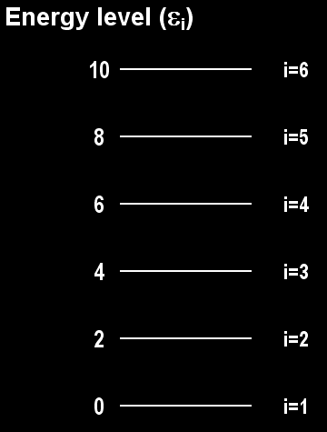
Examples
Total particle (N) = 6
{3,1,2,0,0,0}
E_{total} = 3x0 + 1x2 + 2x4 = 10
{4,0,1,1,0,0}
E_{total} = 4x0 + 1x4 + 1x6 = 10
{3,0,1,2,0,0}
E_{total} = 3x0 + 1x4 + 2x6 = 16

Slide 18
Configuration and Weights
Configuration
  Different configurations have different population of state
Weights
  Number of ways in achieved a particular configuration
Conf. 1
ε₆
ε₅
ε₄
ε₃
ε₂
ε₁
ε₆
ε₅
ε₄
ε₃
ε₂
ε₁
Conf.1 Conf. 2 Conf.3 …
w.1 w. 2 w.3 …

Slide 19
Instantaneous Configuration
Possible energy level (ε₀, ε₁, ε₂ …)
  N molecules
  n₀ molecules in ε₀ state
  n₁ molecules in ε₁ state …
  The instantaneous configuration is {n₀,n₁,n₂…}
  Constraint: n₀+n₁+n₂+… = N
# ways to achieve instantaneous conf. (W)

Slide 20
Examples
{2,1,1}
{1,0,3,5,10,1}

Slide 21
คำถาม (3)
การหาจุดสูงสุด/จุดต่ำสุด ใช้หลักอย่างไร
สภาวะที่มีความน่าจะเป็นสูงสุดที่จะมีอนุภาคเข้าไปอยู่พิจารณาได้จากเงื่อนไขใด

Slide 22
พรุ่งนี้จะใส่เสื้อสีอะไร
มีเสื้อทั้งหมด 25 ตัว
โอกาสที่จะใส่เสื้อสีชมพูเท่ากับ ?
พรุ่งนี้จะใส่ชุดอะไร
  ต้องใส่อย่างน้อย 2 ชิ้น
  โอกาสที่จะใส่เสื้อสีชมพูเท่ากับ ?
  โอกาสที่จะใส่เสื้อสีชมพูกับกระโปรงเท่ากับ ?
20 ตัว 2 ตัว 3 ตัว
20 ตัว 2 ตัว 3 ตัว 1 ตัว 2 ตัว
มีรูปแบบการแต่งตัวกี่แบบ (configuration)
มีจำนวนวิธีแต่งตัวกี่วิธี (way)

Slide 23
Principle of Equal a priori
All possibilities for the distribution of energy are equally probable
The populations of states depend on a single parameter, the temperature.
  If at temperature T, the total energy is 3
  Energy levels: 0, 1, 2, 3
{0,3,0,0} {1,1,1,0} {2,0,0,1}
3
2
1
0
3
2
1
0
3
2
1
0
W=1 W=6 W=3

Slide 24
Possible configurations for 5 molecules
State 1 | 5 | 4 | 4 | 3 | 3 | 3 | 3 | 2 | 2 | 2
State 2 |  | 1 |  | 2 | 1 |  |  | 3 |  | 1 | 1 | 1
State 3 |  |  | 1 |  | 1 | 1 |  |  | 3 | 1 | 1 | 2
State 4 |  |  |  |  |  |  | 1 |  |  | 1 | 1 | 1
State 5 |  |  |  |  |  |  | 1 |  |  |  | 1 | 1
State 6 |  |  |  |  |  | 1 |  |  |  |  | 1 |  | 5
N | 5 | 5 | 5 | 5 | 5 | 5 | 5 | 5 | 5 | 5 | 5 | 5 | 5
E | 5 | 6 | 7 | 7 | 8 | 12 | 12 | 8 | 11 | 11 | 20 | 17 | 30
W | 1 | 5 | 5 | 10 | 20 | 20 | 20 | 10 | 10 | 60 | 120 | 60 | 1
Energy of state j = j

Slide 25
The Dominating Configuration
Some specific configuration have much greater weights than others
There is a configuration with so great a weight that it overwhelms all the rest
  W is a function of all n_{i}: W(n₀, n₁, n₂ …)
  The dominating configuration has the values of n_{i} that lead to a maximum value of W
  The number of molecule constraint :
  The energy constraint :

Slide 26
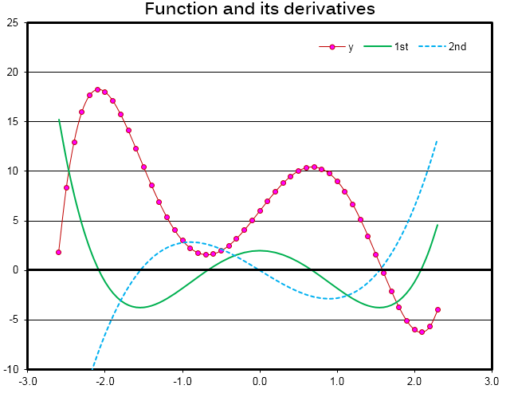
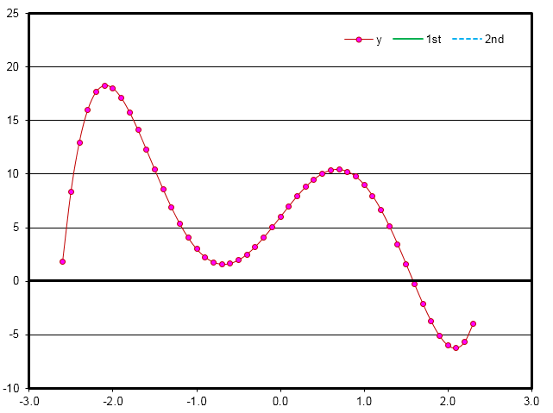
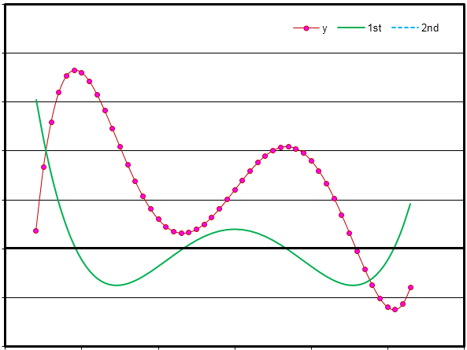
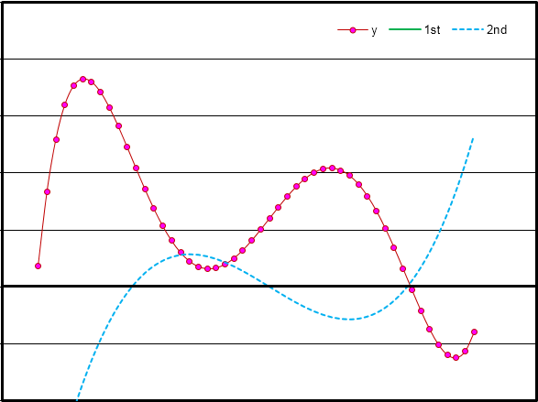
Maximum & Minimum Point
F is a function of x : F(x)
Maximum point:
F ’= 0 ; F ’’ < 0
1st derivative
Minimum point:
F ’= 0 ; F ’’ > 0
2nd derivative

Slide 27
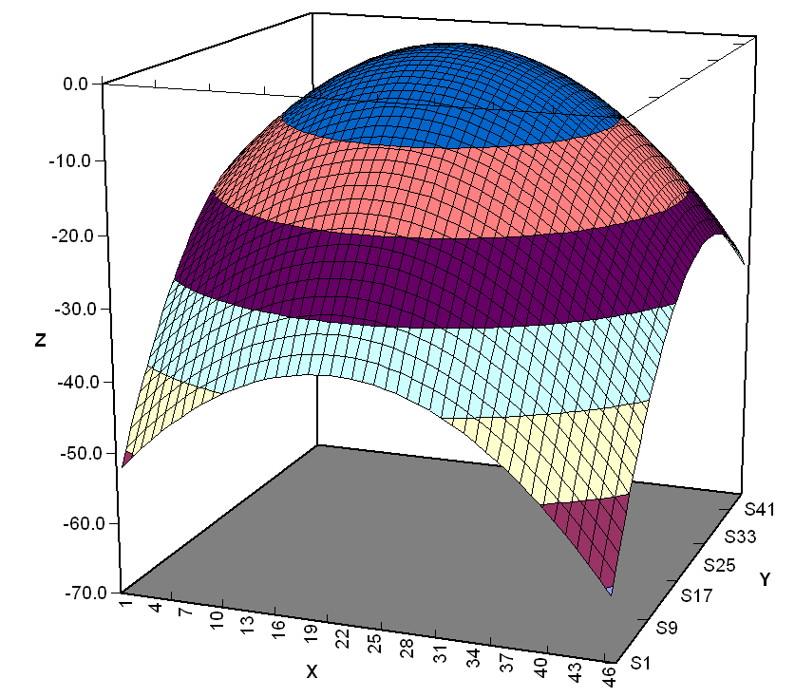
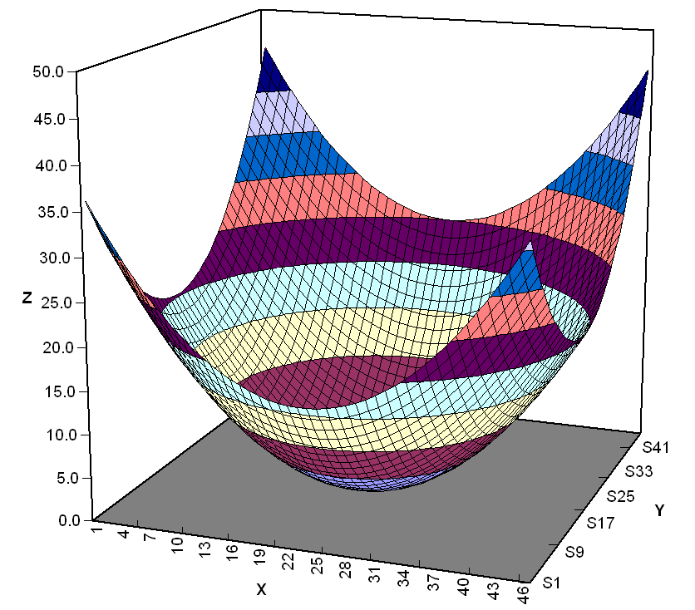
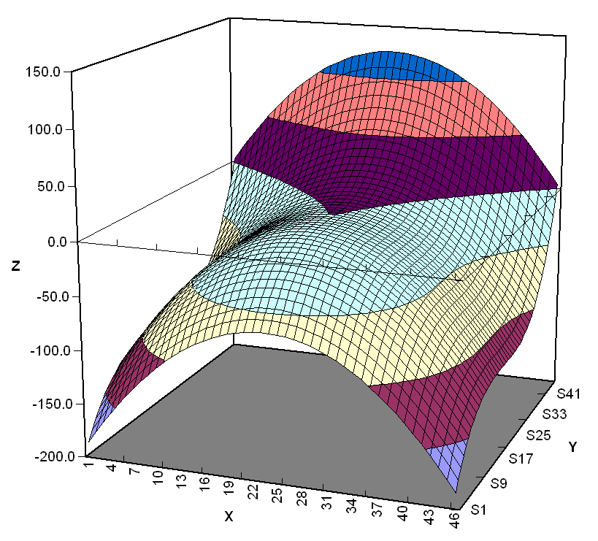
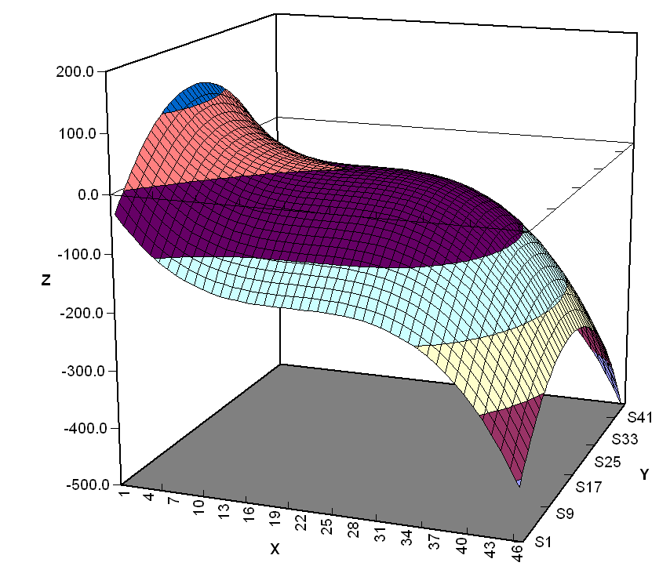
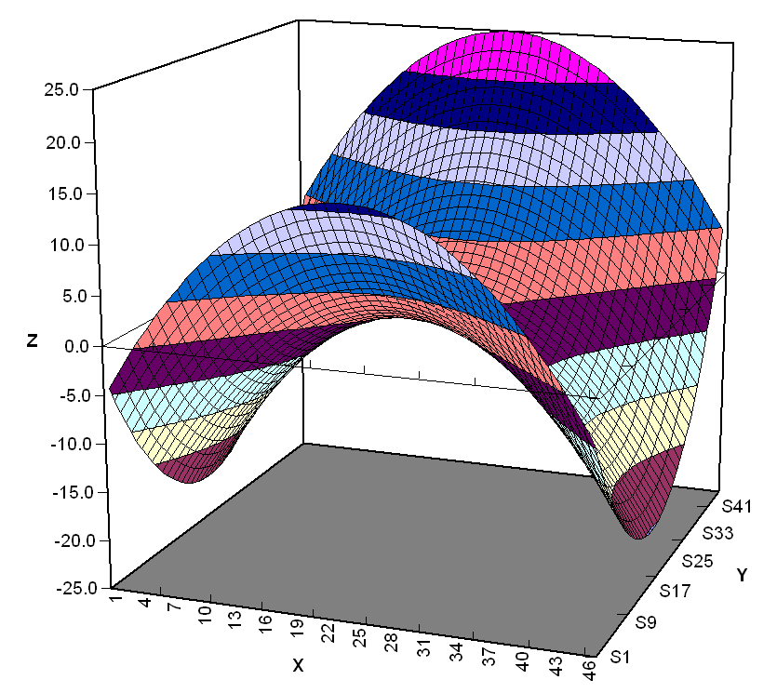
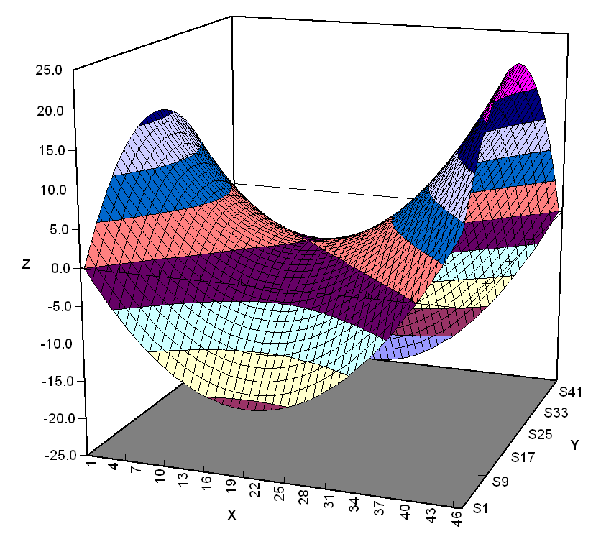
Maximum & Minimum in 3D
F(x,y)

Slide 28
Configuration is defined by a set of n_{i}, {n_{i}}
  W depends on a set of n_{i} or {n_{i}}
At a specific condition, several configurations may be possible
  The configuration with greatest weight (W) will dominate and that configuration can be used to represent the system
  Other configurations with less weight is negligible
Greatest weight
= Dominating Configuration
Weight
Configuration

Slide 29
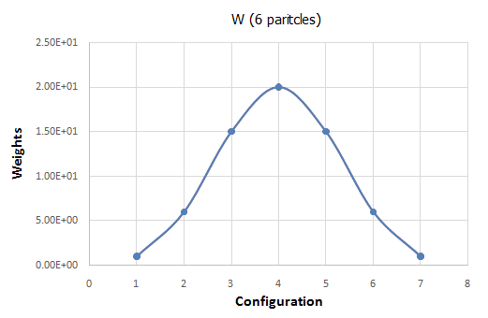
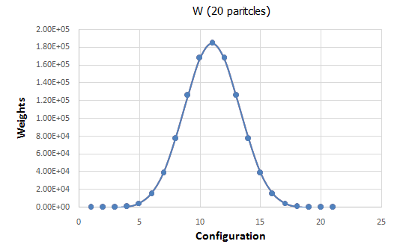
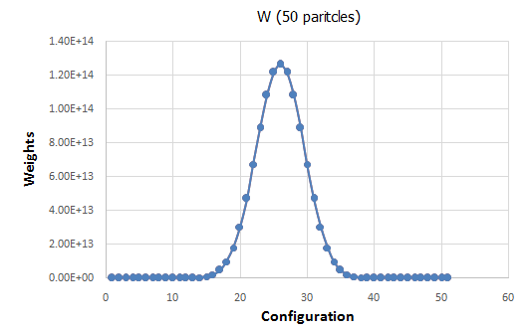
Dominating Configuration
Weight of each configuration
  2 energy states
  Possible configurations (6 particles) :
  {0,6}, {1,5}, {2,4}, {3,3}, {4,2}, {5,1}, {6,0}

Slide 30
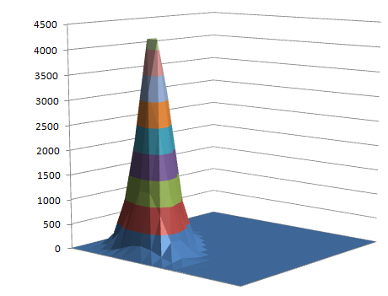
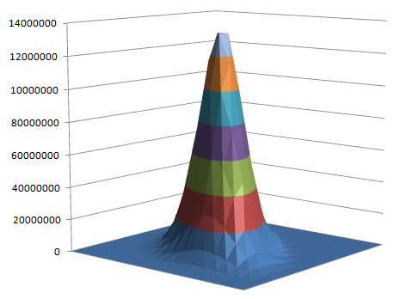
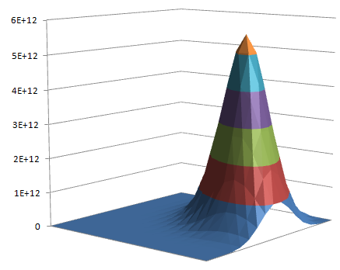
Dominating Configuration
Weight of each configuration
  3 energy states
  Possible configurations (10 particles) :
  {0,0,10}, {0,1,9}, {0,2,8}, … {1,0,9}, {2,0,8}, … {1,1,8} …
10 particles
20 particles
30 particles

Slide 31
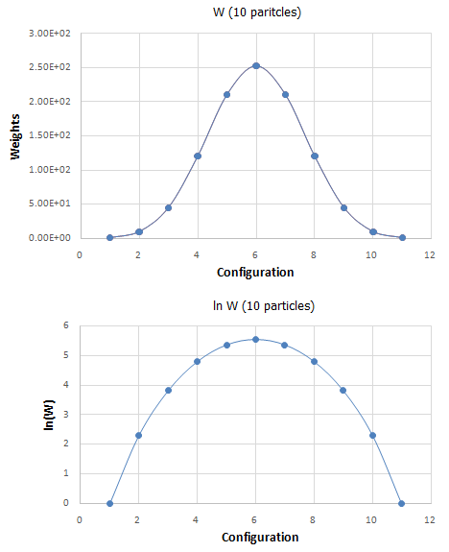
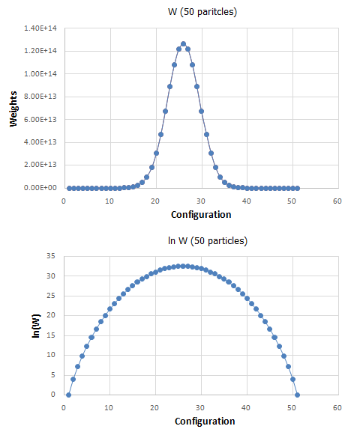
Maximum Value of W{n_{i}}
We are looking for the best set of n_{i} that yields maximum value of ln(W)
  Maximum W = W{n_{i,max}}
  Maximum ln W = ln W{n_{i,max}}
{n_{i,max}} = ?

Slide 32
Maximum Value of W{n_{i}}
{n_{i,max}} can be determined by differentiate
Constraints
  Total particle (N) is constant
  Total energy (E) is constant

Slide 33
คำถาม (4)
หลังจากการแก้สมการโดยใช้วิธี Undermined multiplier คำตอบที่เราได้และสามารถนำไปใช้ต่อได้คืออะไร
ความน่าจะเป็นที่อนุภาคจะอยู่ที่สภาวะ i ขึ้นกับตัวแปรใด

Slide 34
Maximum Value of W{n_{i}}
Maximum ln(W) plus Constraints
Method of undetermined multipliers

Slide 35
Stirling’s Approximation
Natural logarithmic of the weight
  Stirling’s Approximation
The approximation for the weight
If x is large

Slide 36
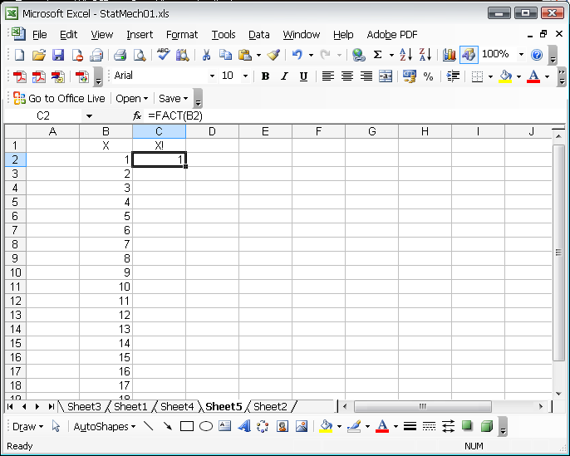
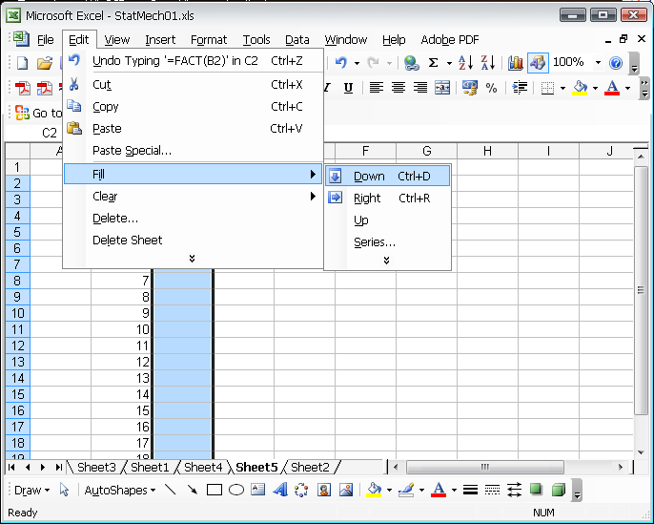
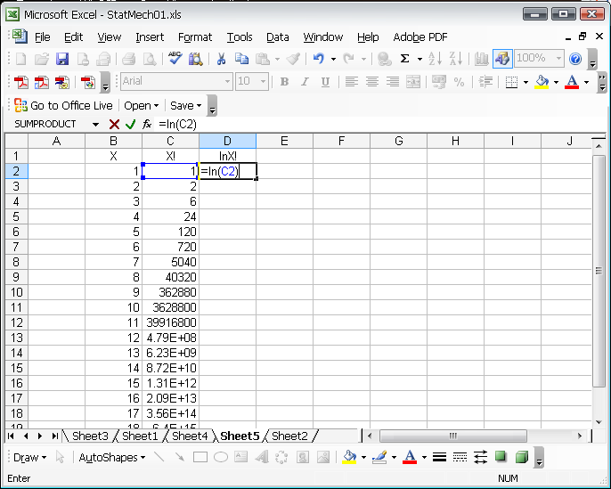
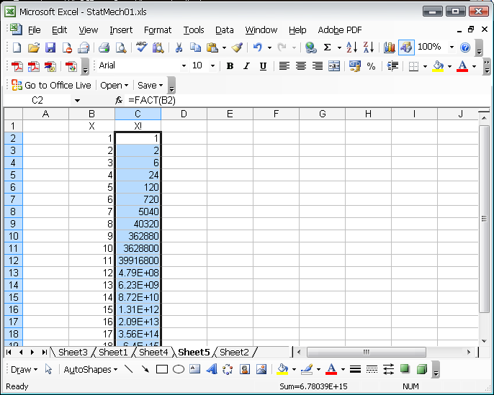
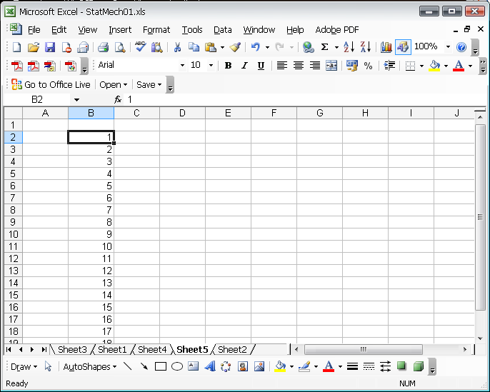
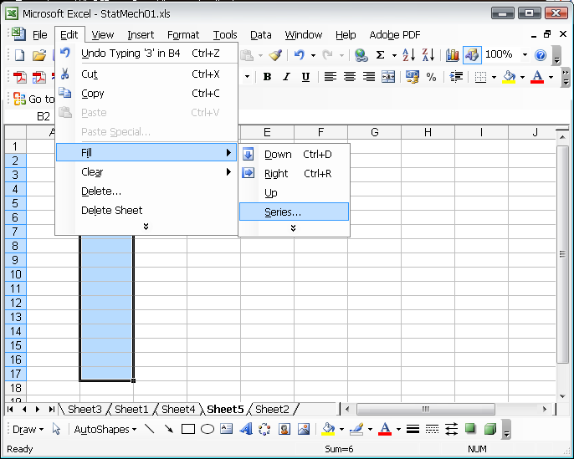
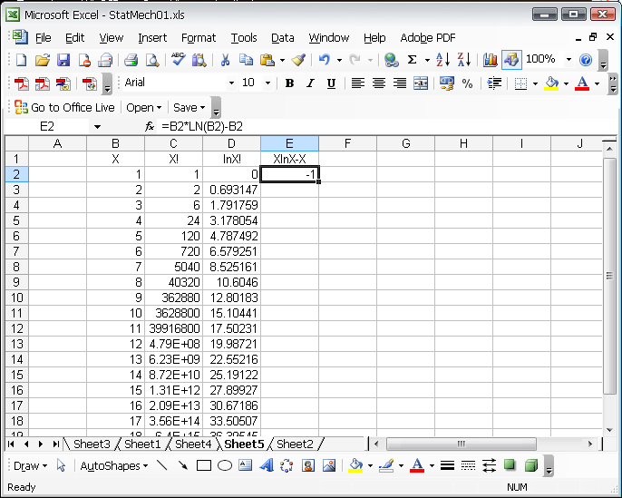
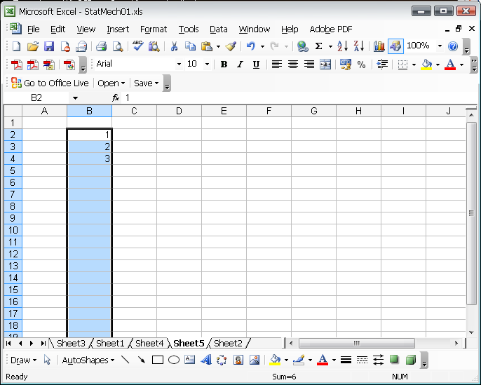
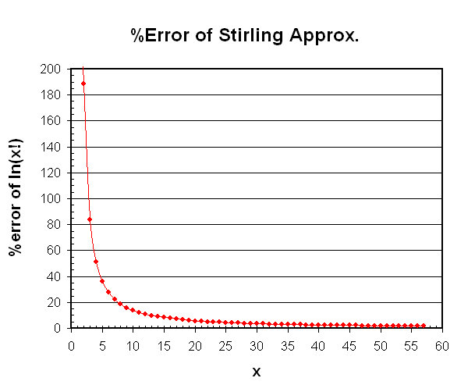
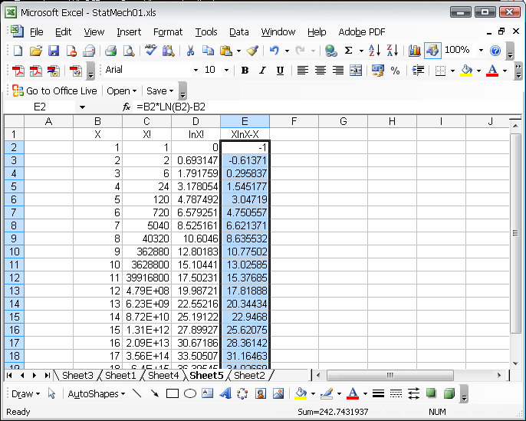
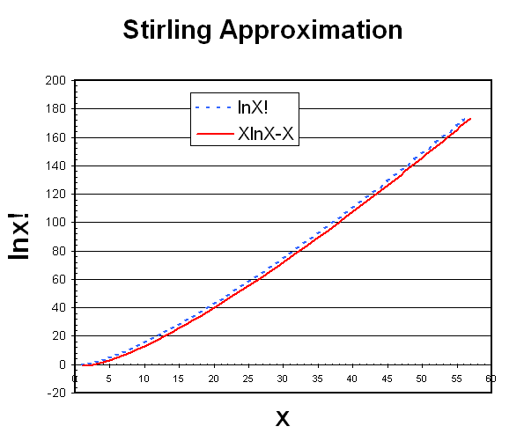
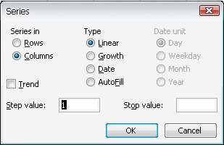
Homework (1)
when x is a large number!
1.67%

Slide 37
Eq. 1
Eq. 1 is possible if (and only if) …
ε_{i} is relative energy

Slide 38
คำถาม (5)
ที่อุณหภูมิสูง ๆ อนุภาคส่วนใหญ่จะอยู่ในระดับพลังงานใด อธิบายเหตุผลประกอบด้วย
Partition function คืออะไร (สมการและความหมาย) และ มีประโยชน์อย่างไร

Slide 39
The Boltzmann Distribution
The populations in the configuration of the greatest weight depend on the energy of the state
  The fraction of molecules in the state i (p_{i}) is
***
The Molecular Partition Function
(Z,q,Q)
Sum over all states (i)
Sum over energy level (j)
Boltzmann constant = 1.38x10⁻²³ J/K
degeneracy

Slide 40
The Molecular Partition Function
An interpretation of the partition function
  at very low T ( T→0)
  β → ∞
  at very high T ( T→∞)
  β → 0
  The molecular partition function gives an indication of the average number of states that are thermally accessible to a molecule at the temperature of the system
(infinity # of energy levels)

Slide 41
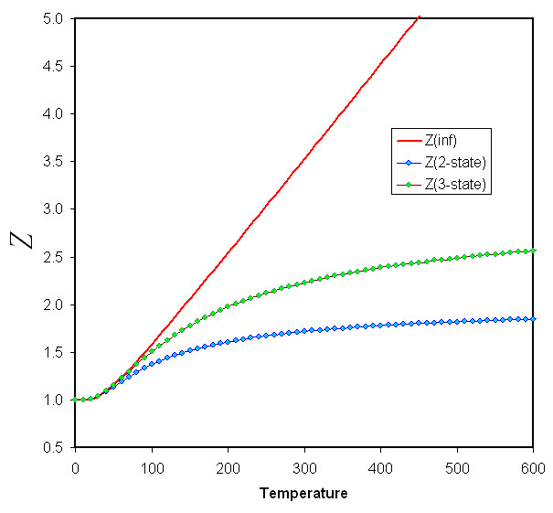
Uniform Energy Levels
Equally spaced non-degenerate energy levels
  Finite number
  Infinite number
ε₀= 0 ε₁= ε ε₂= 2ε ε₃= 3ε …
ε₃
ε₂
ε₁
ε₀
ε
Infinite # of energy levels
Finite # of energy levels

Slide 42
What are the possible states of particles at high temperature?
  High-energy states?
  Low-energy states?
  All states?

Slide 43
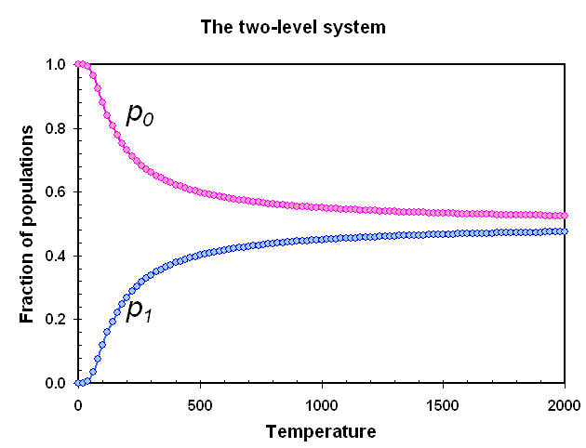
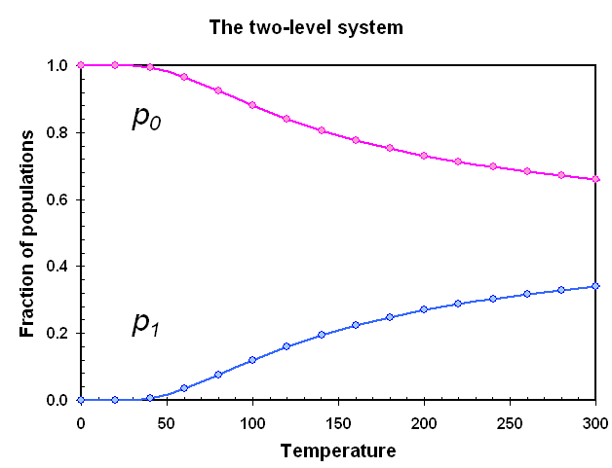
The Possibility *
The possibility of molecules in the state with energy ε_{i} (p_{i})
The possibilities of molecules in the 2-level system
Z of infinite # of energy levels*
As T → ∞ the populations of all states (p_{i}’s) are equal.

Slide 44
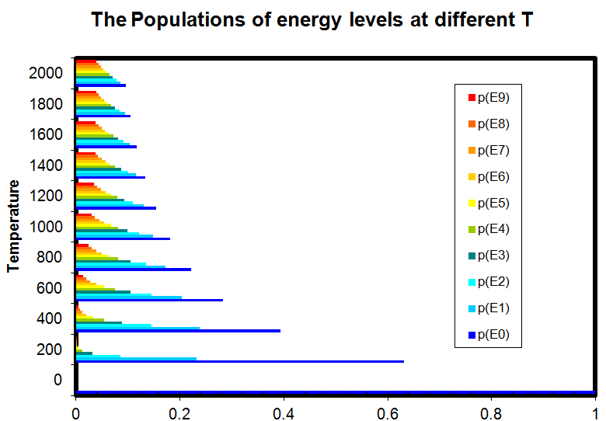
The possibilities of molecules in the infinite-level system*
As T → ∞
the populations of all states are equal.

Slide 45
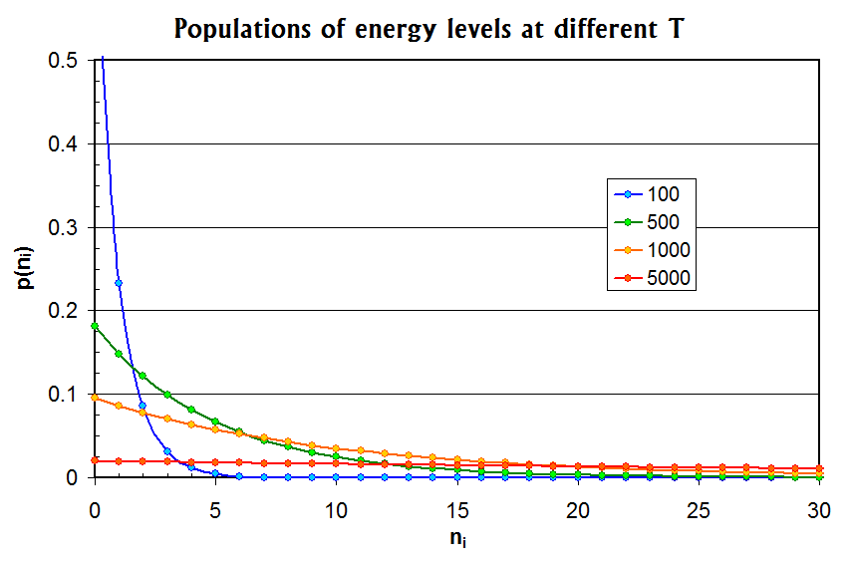
Temperature

Slide 46
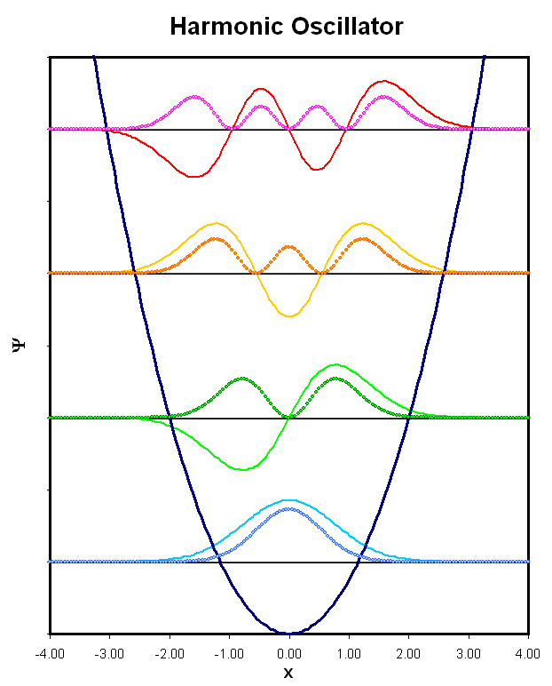
Examples
Vibration of I₂ in the ground, first- and second excited states (Vibrational wavenumber is 214.6 cm⁻¹)
Relative energy

Slide 47
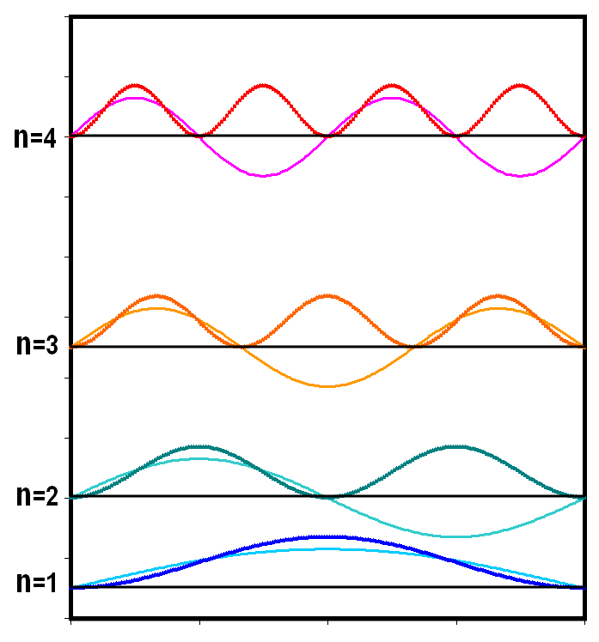
Approximations and Factorizations
In general, exact analytical expression for partition functions cannot be obtained.
  Closed approximation expressions to estimate the value of the partition functions are required for each systems
Energy levels of a molecule in a box of length X
Relative energy

Slide 48
Translational Partition Function
Partition function of a molecule in a box of length X
The translation energy levels are very close together, therefore the sum can be approximated by an integral.
Transitional partition function
Make substitution: x²=n²βε and dn = dx/(βε)^{1/2}

Slide 49
When the energy of a molecule arises from several different independent sources
  E = E_{x}+E_{y}+E_{z}
  q = q_{x}q_{y}q_{z}
A molecule in 3-d box

Slide 50
Λ is called the thermal wavelength
The partition function increases with
  The mass of each particle (m^{3/2})
  The volume of the container (V)
  The temperature (T^{3/2})

Slide 51
Example
Calculate the translational partition function of an H₂ molecule in 100 cm³ vessel at 25°C
  More than 10²⁶ quantum states are thermally accessible at room temperature

Slide 52
คำถาม (6)
ระบบที่มีระดับพลังงานเป็น เมื่อ i=1-5
  ข้อใดถูก
    เป็นแบบ non-degerated
    เป็นแบบ finite #
    เป็นแบบ Uniform
    เป็นแบบ equally spaced
  ค่าต่อไปนี้มีค่าเท่าใด
    ε₀
    ε₁
    ε₂

Slide 53
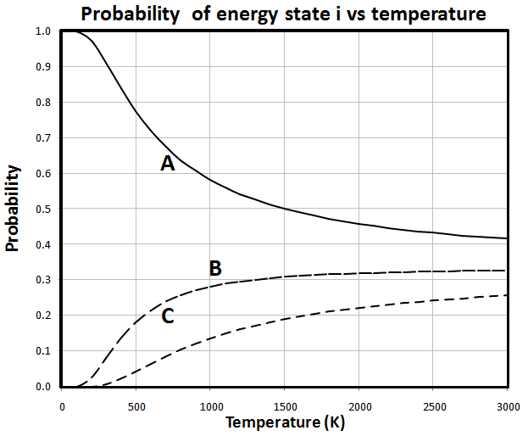
คำถาม (7)
กราฟ A แสดงอะไร
ที่อุณหภูมิเข้าใกล้ ∞ กราฟ A, B, C จะมีค่าเท่าใด
จากกราฟจงบอกข้อมูลต่อไปนี้
  จำนวนอนุภาคทั้งหมด
  จำนวน state ทั้งหมด
  ค่าระดับพลังงานของแต่ละ state
Accessible แปลว่าอะไร
Disposal แปลว่าอะไร

Slide 54
The Internal Energy and Entropy
The molecular partition function contains all information needed to calculate the thermodynamic properties of a system of independent particles
  q ≈ Thermal wave function
The Internal Energy **
Boltzmann distribution→

Slide 55
Relative energy
3ε
2ε
ε
0
Total energy
  ε_{i} is relative energy (ε₀=0)
  E is internal energy relative
  to its value at T=0
The conventional Internal Energy (U)
ε₃
ε₂
ε₁
ε₀
ε
A system with N independent molecules
q=q(T,X,Y,Z,…)
Only the partition function is required to determine the internal energy relative to its value at T=0.
***

Slide 56
Example
The two-level partition function
At T = 0 : E → 0
all are in lower state (ε=0)
As T → ∞ : E → ½ Nε
two levels become equally populated

Slide 57
The value of β
The internal energy of monatomic ideal gas
  For the translational partition function
This result is also true for general cases.

Slide 58
1 amu = ? g
¹²C 1 mol = 12 g
¹²C 1 atom = 12 amu
¹²C 1 mol = 6.02x10²³ atom
1 amu = 1g/6.02x10²³ =1.66x10⁻²⁷ kg

Slide 59
Temperature and Populations
When a system is heated,
  The energy levels are unchanged
  The populations are changed
HEAT
ε₁₀
ε₉
ε₈
ε₇
ε₆
ε₅
ε₄
ε₃
ε₂
ε₁
ε₀
ε₁₀
ε₉
ε₈
ε₇
ε₆
ε₅
ε₄
ε₃
ε₂
ε₁
ε₀
Increase T

Slide 60
Volume and Populations
Translational energy levels
When work is done on a system,
  The energy levels are changed
The populations are changed
WORK
ε₁₀
ε₉
ε₈
ε₇
ε₆
ε₅
ε₄
ε₃
ε₂
ε₁
ε₀
ε₅
ε₄
ε₃
ε₂
ε₁
ε₀
decrease V

Slide 61
คำถาม (8)
Thermal wavefunction
  คืออะไร
  ต่างจาก wave function อย่างไร
Partition function มีประโยชน์อย่างไร

Slide 62
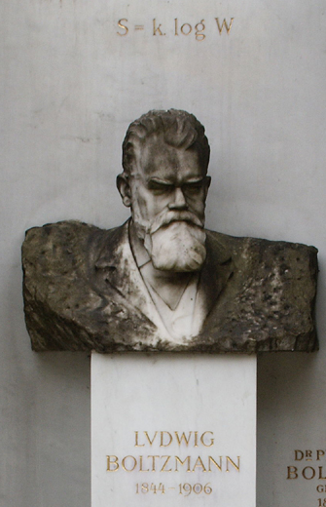
The Statistical Entropy
The partition function contains all thermodynamic information.
  Entropy is related to the disposal of energy
  Partition function is a measure of the number of thermally accessible states
Boltzmann formula for the entropy
    As T → 0, W → 1 and S → 0
***

Slide 63
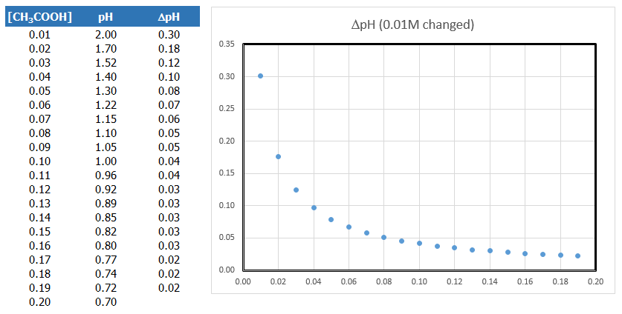
Logarithmic Relation

Slide 64
Maxwell’s Relations
Euler’s reciprocity relation
Maxwell equations

Slide 65
Entropy and Weight
A change in internal energy
  When the system is heated at constant V, the energy levels do not change.
    From thermodynamics,

Slide 66
Calculating the Entropy
Calculate the entropy of N independent harmonic oscillators for I₂ vapor at 25ºC
  Molecular partition function:
  The internal energy:
  The entropy:

Slide 67
Entropy and Temperature
What do we know from the graph?
  T increases, S increases
  What else?

Slide 69
Summation
  Sum over state
  i = 1-15
  Sum over energy level
  j = 1-7
3d
4s
3p
3s
2p
2s
1s

Slide 70
Real life problem
English Premier League
  20 football clubs
  Host-Guest matches
  How many matches for each club?
  How many matches for the whole league?

Slide 71

Dice
Chance to get 5 from 1 dice
Probability to get 5 from 1 dice
How many way (chance) to get 5 from 2 die?
  1,4 2,3 4,1 3,2
  What is the probability to get 5 from 2 dice?
  Probabilities to get 1,4 and 2,3 are equal?
How many way to get 6 from 3 die?
  1,2,3 2,2,2 1,1,4
  Probabilities to get 2,2,2 and 1,2,3 are equal?

Slide 72
Configuration
Configuration of throwing dice
  to get 6 with 3 die
  {2,0,0,1,0,0} {1,1,1,0,0,0} {0,3,0,0,0,0}
  Probabilities to get {2,0,0,1,0,0} and {0,0,0,0,2,1} are equal
  Probability to get each configuration doesn’t depend on the face of dice!

Slide 73
All possible chance to throw 6 die = 6!
All possible chances to get {0,6,0,0,0,0}
All possible chances to get {0,4,0,1,1,0}
6!
4!
1!
1!
0!

Slide 74
To get 10 from 3 die
  All possible chances are 24
  The most likely configurations are {0,1,1,0,1,0}, …
Face | Configuration
1 |  | 1 | 1
2 | 2 |  |  | 1
3 |  | 1 |  | 1 | 2
4 |  |  | 1 |  | 1
5 |  |  | 1 | 1
6 | 1 | 1
W | 2 | 6 | 6 | 6 | 3

Slide 75
To get 10 from 4 die
  All possible chances are 40
  The most likely configuration is {1,1,1,1,0,0}
Face | Configuration
1 | 2 | 1 | 2 | 2 | 1 |  |  | 1
2 | 1 | 2 |  |  | 1 | 3 | 2
3 |  |  | 1 |  | 1 |  | 2 | 3
4 |  |  |  | 2 | 1 | 1
5 |  | 1 | 1
6 | 1
W | 12 | 12 | 12 | 6 | 24 | 4 | 6 | 4

