Slide 1
Physical Chemistry IV 01403343 The Ensemble
Piti Treesukol
Chemistry Department
Faculty of Liberal Arts and Science
Kasetsart University : Kamphaeng Saen Campus

Slide 2
คำถาม (9)
Ensemble คืออะไร
Ensemble มีประโยชน์อย่างไร
ตัวแปรต่อไปนี้คืออะไร

Slide 3
Evolving System
at t₀
N, V, E are constant, therefore {n_{i}}, X
at t₀
N, V, T are constant, therefore {n_{j}}, X₀
at t₁
N, V, E are constant, therefore {n_{i}}, X
at t₁
N, V, T are constant, therefore {n_{j}} changed, X₁
at t₂
N, V, E are constant, therefore {n_{i}}, X
at t₂
N, V, T are constant, therefore {n_{j}} changed, X₂
Observable = X
Observable = X over time

Slide 4
Event is a series of consecutive pictures of evolving system.
System is changing with time.
Equilibrium?
Changes?

Slide 5
Parallel World
T
3
4
5
6
7
7
7
A
9
10
11
12
12
13
14
B
5
6
7
7
7
8
9
C
T_{i}
Average over time = average over a group of identical systems

Slide 6
The Other Meaning *
The whole system can be considered as a collection of sub-systems
Each of sub-systems are identical but can behave differently at the same time
We may consider only one sub-system and use statistic to replicate the rest of the whole system
j
i
k

Slide 7
Ensemble
Ensemble is a collection of imaginary replication of the system
Number of replications is arbitrary:
Number of systems in E_{i} state is

Slide 8
The study of thermodynamics is concerned with systems which can be described simply by a set of macroscopically observable variables. These systems can be described by statistical ensembles that depend on a few observable parameters, and which are in statistical equilibrium.
Microcanonical ensemble — the total energy of the system and the number of particles in the system are each fixed to particular values; each of the members of the ensemble are required to have the same total energy and particle number. The system must remain totally isolated.
Canonical ensemble — the energy is not known exactly but the number of particles is fixed. In place of the energy, the temperature is specified. The canonical ensemble is appropriate for describing a closed system which is in, or has been in, weak thermal contact with a heat bath. In order to be in statistical equilibrium the system must remain totally closed.
Grand canonical ensemble — a statistical ensemble where neither the energy nor particle number are fixed. In their place, the temperature and chemical potential are specified. The grand canonical ensemble is appropriate for describing an open system.

Slide 9
Types of Ensemble
Microcanonical ensemble : N, V, E common
Canonical ensemble : N, V, T common
Grand canonical ensemble : μ, V, T common

Slide 10
Canonical Ensemble
Canonical Ensemble: A canonical ensemble is a statistical ensemble representing a probability distribution of microscopic states of the system.
All systems are in thermal equilibrium (T)
Volumes (V) and compositions (N) of each systems are equal
Configuration of the Ensemble and its weight

Slide 11
Dominating Configurations
Some of the configuration, , of the ensembles will be very much more probable than others.
Energy of the whole ensemble
In the thermodynamic limit, , the dominating configuration is overwhelmingly the most probable, and it dominates the properties of the system virtually completely
{1,6,1,1,1,1,1,0,0}
{11,0,0,0,0,0,0,0,1}

Slide 12
The weight of a configuration is
The configuration of greatest weight, subject to the total energy and composition constraints is given by the canonical distribution
Canonical Distribution
Canonical Partition Function

Slide 13
Fluctuations from the Most Probable Distribution
The probability of an ensemble having a specified energy is given by the probability of state times the number of state
Low energy states are more probable than the higher ones
There may be numerous states with almost identical energies
The density of states is a very sharply increasing function of energy
Most members of the ensemble have an energy very close to the mean value
Probability of Energy
Probability of States
Number of States
Energy

Slide 14
แบบ vs ราคา ?
10,000
5,000
2,000
500
100
1,000

Slide 15
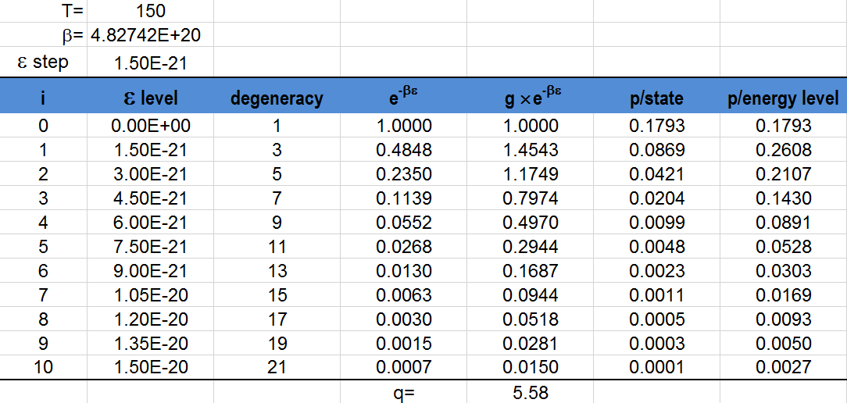
Probability of degenerated system
Σ ≠1
Σ = 1

Slide 16
The Thermodynamic Information
The canonical partition function (Q) carries all the thermodynamic information about a system
Q dose not assume that the molecules are independent.
The Internal Energy: (average energy of each system)
~
as N → ∞

Slide 17
The Entropy:
The total weight of a configuration of the ensemble is the product of the average weight of each member of the ensemble;
The entropy

Slide 18
Independent Molecules
When the molecules are independent
Distinguishable independent molecules:
Indistinguishable independent molecules:
Distinguishable ?

Slide 19
The Entropy of a Monatomic Gas
For indistinguishable independent molecules
Using Stirling Approximation
The partition function is due to the translation only
n is number of mole

Slide 20
For monatomic gas
For monatomic perfect gas
When a monatomic perfect gas expands isothermally from V_{i} to V_{f}:
Sackur-Tetrode equation
V_{i}
V_{f}
Δs=?

Slide 21
Example
Calculate the standard molar entropy of Ar(g) at 25 °C
What is the difference to Calculate the standard molar entropy of H₂(g), instead of He(g)?

Slide 22
Configuration
Weight
Microstates
Stirling Approximation
Partition Function
T → 0
T → ∞
Energy levels
Translation
Vibration
Rotation
Effect of T and V
Thermal Wavelength
Determining Thermodynamics Properties
Ensemble
Canonical Ensemble

Slide 23
1
2
3
6
6
1
3
6
1
4
3
2
4
5
6
6
1
1
2
1
2
3
2
2
1
1
1
4
2
3
2
3
3

Slide 24
Metaphor
คนเรียนจบเคมี มก.กพส. มีเงินเดือนเท่าไร
มีคนเรียนจบหลายคน
แต่ละคนมีคุณภาพเท่าเทียมกัน
แต่ละคนจบไม่พร้อมกัน เริ่มทำงาน/อายุงานไม่เท่ากัน
ต้องการข้อมูลในภาพรวม
ค่าเฉลี่ยเงินเดือนของทุกคนที่จบ เฉลี่ยเทียบกับจำนวนคน
ค่าเฉลี่ยเงินเดือนของแต่ละคนที่จบ (เงินเดือนเพิ่มขึ้นหรือลดลงขึ้นกับตำแหน่ง เศรษฐกิจ ประสบการณ์ พฤติกรรม) เฉลี่ยเทียบกับเวลา (ในช่วงที่สนใจ)

