Slide 1
Physical Chemistry IV 01403343 The Use of Statistical Thermodynamics
Piti Treesukol
Chemistry Department
Faculty of Liberal Arts and Science
Kasetsart University : Kamphaeng Saen Campus

Slide 2
Thermodynamics & Partition Functions
A Partition function is the bridge between thermodynamics, spectroscopy, and quantum mechanics.
Thermodynamics functions
Mean energies
Heat capacities
Equation of state
Residue entropies
Equilibrium constants

Slide 3
Maxwell Relation

Slide 4
Thermodynamics Functions
Expressions to calculate thermodynamics functions from canonical partition function.
For independent distinguishable system
For independent indistinguishable system

Slide 5
Other Thermodynamics Functions
The Helmholtz energy
The Pressure
The Enthalpy

Slide 6
Other Thermodynamics Functions
The Gibbs energy
For an ideal gas
For indistinguishable molecules

Slide 7
The Molecular Partition Function
The energy of a molecule is the sum of contribution from its different modes of motion.
The separation of energy is only approximation.
Born-Oppenheimer Approximation
Rigid Rotor Approximation
The partition function is a product of each contributions.

Slide 8
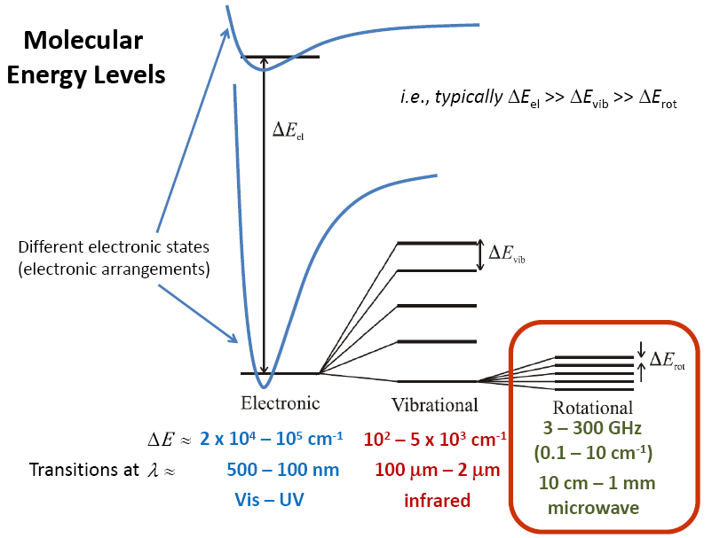

Slide 9
คำถาม 11
ค่า partition function q^{T} q^{V} q^{R} q^{E} คืออะไร
แต่ละชนิดที่มีค่าแตกต่างกันอย่างไร
ค่า θ^{R} และ θ^{V} คืออะไร มีประโยชน์อย่างไร

Slide 10
Partition Function Contributions
The Translation Contribution
The approximations are valid if many states are occupied
Λ is small compared to the container
H₂ at 25 ˚C Λ = 71 pm V=1L → q=2.73x10²⁷
O₂ at 25 ˚C Λ = 18 pm V=1L → q=1.75x10²⁹

Slide 11
Rigid Rotors

Slide 12
Moment of Inertia
Angular Mass / Rotational Inertia
Moment of Inertia of a Molecule
m_{H}
m_{O}
m_{H}

Slide 13
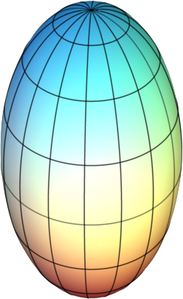
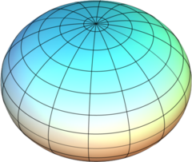
Rigid Rotor
Principal Rotational Axes (A,B,C) I_{c} ≥ I_{b} ≥ I_{a}
Spherical rotors (I_{a}=I_{b}=I_{c}) CH₄, CCl₄
Symmetric rotors
Oblate (I_{a} =I_{b}< I_{c}) C₆H₆, NH₃
Prolate (I_{a} < I_{b}= I_{c}) CHCl₃
Asymmetric rotors (I_{a} < I_{b} < I_{c})
Oblate top
Prolate top
α
m_{i}
r_{i}
http://www.unomaha.edu/tiskochem/Chem3360/

Slide 14
Partition Function Contributions
The Rotational Contribution
Linear Rotors:
Nonlinear Rotors:
Rotational Temp.
Approximation is valid when T >> θ_{R}
Symmetric Molecule
σ is the symmetry number (identity and rotation; E, nC_{x})
Heter.diatomic σ = 1, Homo.diatomic σ = 2
Degeneracy Rotational constant
Approximation is valid when many rotational levels are populated.

Slide 15
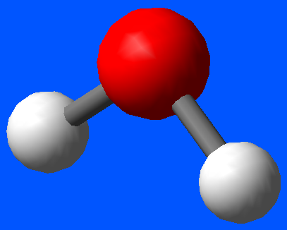
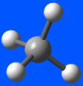
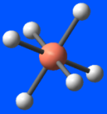
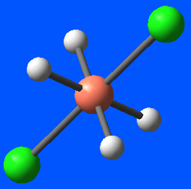
The Rotational Energy Levels
Spherical rotors
Symmetric rotors
a
Angular velocity
Moment of inertia
b
c
Angular momentum
Rotational term (wave number)
J=0,1,2… K=0,±1,±2,…

Slide 16
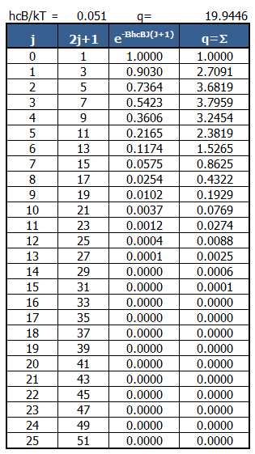
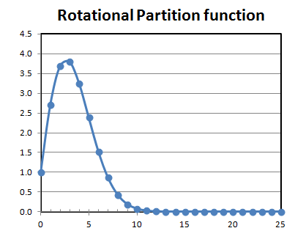
Rotational Partition function of HCl
B = 10.591 cm⁻¹
hcB/kT = 0.051
contribution
J

Slide 17
Metaphor
ลงทะเบียนเรียน 3 วิชา
วิชา 1 (สอบ 4 ครั้ง ครั้งละ 25 คะแนน เกรด A >75 B>65 C>55 D>45)
วิชา 2 (สอบ 5 ครั้ง ครั้งละ 20 คะแนน เกรด S >50)
วิชา 3 (สอบ 3 ครั้ง ครั้งละ 33 คะแนน เกรด A >80 B>60 C>40)
q^{i} คือจำนวนเกรดที่เป็นไปได้ของวิชา i
θ_{i} จำนวนครั้งเข้าสอบของวิชา i ขั้นต่ำที่จะมีโอกาสผ่าน
i | θ_{i} | เข้าสอบ | q^{i}
1
2
3
2
3
1
2
? (1-5)
ถ้าเข้าสอบ < θ_{i} q^{i}=1 (F)
3
1
q_{total} =q¹ x q² x q³
2
? (1-3)

Slide 18
Partition Function Contributions
The Vibration Contribution
Large vibrational wavenumber
Small vibrational wavenumber
Vibrational temperature
At high Temp (T>>θ_{V})
υ = 0,1,2,…

Slide 19
Partition Function Contributions
The Electronic Contribution
Electronic energy separations from the ground state are usually very large. In most cases q^{E}=1 and q^{E}=g^{E} for degenerate ground-state systems.
For low-lying electronically excited state (at high temp?)

Slide 20
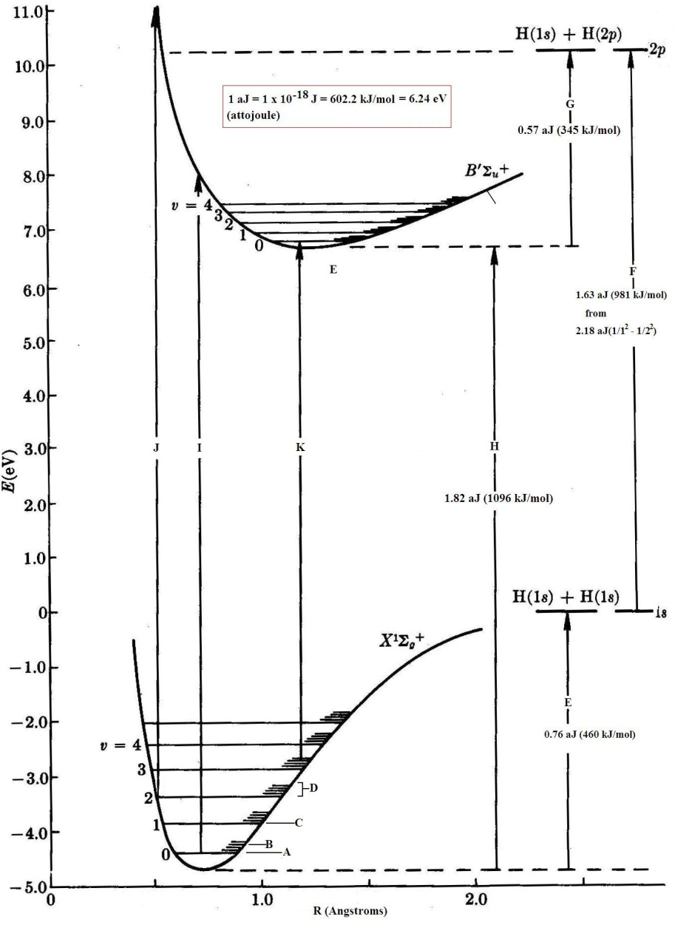
Energy Levels

Slide 21
HW1
Download File statmech02.xlsm from the website
Due date is March, 14th
Don’t copy file from others!!!

Slide 22
คำถาม 12
ความจุความร้อนคืออะไร
ที่อุณหภูมิสูง ๆ ค่าความจุความร้อนของสารจะมีค่ามากขึ้นหรือน้อยลงเพราะเหตุใด
Δ_{vap}S มีค่ามากหรือน้อยกว่า Δ_{fus}S เพราะเหตุใด

Slide 23
The Overall Partition Function
For a diatomic molecule with no low-lying electronically excited states and T>>θ_{R}
★
★
★

Slide 24
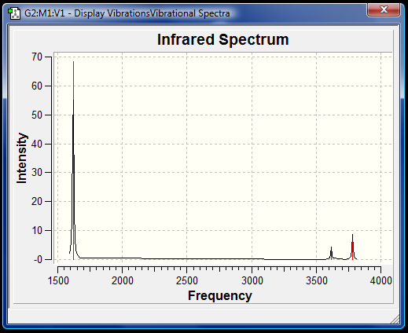
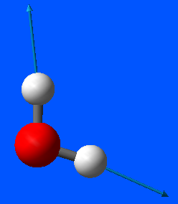
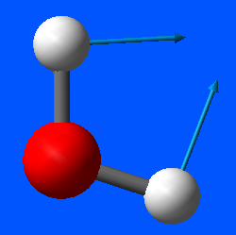
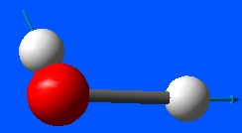
Example: Vibrational Partion Function
Three normal modes of H₂O Evaluate the vibrational partition functions at 1500 K
At 1500 K
Mode | 1 | 2 | 3
 | 3656.7 | 1594.8 | 3755.8
 | 3.507 | 1.530 | 3.602
 | 1.031 | 1.276 | 1.028
1594.8 cm⁻¹
3656.7 cm⁻¹
3755.8 cm⁻¹

Slide 25
Using Statistical Thermodynamics
Any thermodynamic quantity can be calculated from a knowledge of the energy levels of molecules.
Mean Energy of various modes of motion
The mean translation energy 1-D system of length X 3-D system

Slide 26
The mean rotational energy (for a linear molecule)
when T< θ_{R}
when T>> θ_{R}

Slide 27
The mean vibrational energy (harmonic approx.)
At high temp. e^{x} = 1+x+…
Relative energy related to the zero-point energy

Slide 28
Heat Capacity
At constant Volume q = ΔU
At constant Pressure q = ΔH

Slide 29
Heat Capacity
The constant-volume heat capacity
The internal energy of a perfect gas is a sum of contributions, the heat capacity is also a sum of contribution from each mode.
dT (+)
dU (+)
q

Slide 30
Individual Contributions
The molar constant-volume heat capacity
Translation is the only mode of motion for a monoatomic gas
Rotation contributes to the heat capacity only at high T
At high temp,
Diatomic molecules
Vibration contributes to the heat capacity only at high T
The maximum contribution is R and the lowest is 0.
For non linear molecules
For linear molecules

Slide 31
The Overall Heat Capacity
The total heat capacity of a molecular substance is the sum of each contribution.
If T >> θ_{m}, equipartition is valid. The heat capacity can be estimated by counting the number of modes that are active.
For gases;
Each of three translational modes: ½ R
Each of active ν_{R} rotational modes: ½ R
Each of active ν_{V} vibrational modes: R
-
-
-
-
-
-
-
-
4
3
2
1
C_{V,m}/R
| |
θ_{R} θ_{V}
Temp.
Dissociation
In thermal equilibrium, energy is shared equally among all of its various forms; for example, the average kinetic energy per degree of freedom in the translational motion of a molecule should equal that of its rotational motions

Slide 32
Example
Estimating the C_{V,m} of H₂O(g) at 373 K Vibration modes: 3656.7 1594.8 3755.8 cm⁻¹ Rotational constants: 27.9 14.5 9.3 cm⁻¹
θ_{M} of each modes:
Mode | cm⁻¹ | K
Rotation | 27.9 | 40.15
 | 14.5 | 20.87
 | 9.3 | 13.38
Vibration | 3656.7 | 5261.99
 | 1594.8 | 2294.92
 | 3755.8 | 5404.60
Expt. Value = 26.1 JK⁻¹

Slide 33
Equation of State
An equation of state is
a relation between state variables.
a thermodynamic equation describing the state of matter under a given set of physical conditions.
Ideal gas
VDW
Verial
Etc.

Slide 34
Equations of State
Statistical Mechanics
Configuration partition function (Z)
Canonical Partition Function (Q)
pair potentials
ideal gas (E_{p}=0)
← E_{p} = intermolecular potential

Slide 35
Residual Entropy
The entropy at any temperature may be determined from
Some disorder is present in the solid even at T=0.
The entropy at T=0 is called residual entropy.
Entropy
Temperature

Slide 36
Origin of Residual Entropy
A crystal composed of AB molecules, wher A and B are similar atoms (such as C and O in CO). AB AB AB AB … ↔ AB BA BA AB … ↔
Random orientations in solid with small energy different
The entropy arises from residual disorder by
The total number of ways of achieving the same energy
For solids composed of molecules that can adopt s orientations
2 possible orientations
5.8 JK⁻¹mol⁻¹

Slide 37
Residual entropies of molecules
CO ( 5 JK⁻¹)
FClO₃ ( 10.1 JK⁻¹)
H₂O(s) ( 3.4 JK⁻¹)

Slide 38
คำถาม 13
ค่า K มีค่าน้อยที่สุดและมากที่สุดเท่าไร
ค่า K มีหน่วยอะไร เพราะเหตุใด
ถ้าค่า K มีค่ามาก หมายความว่าอย่างไร

Slide 39
Equilibrium Constant
The equilibrium constant of a chemical reaction is the value of the reaction quotient when the reaction has reached equilibrium.
aA + bB cC + dD

Slide 40
Equilibrium Constant
The equilibrium constant K of a reaction is related to standard Gibbs energy of reaction:
The relation between K and the partition function
Standard Molar Gibbs energy of species J
Standard molar partition function:
Standard pressure; only q_{T} depends on p

Slide 41
Equilibrium constant
The equilibrium constant for the reaction aA + bB → cC + dD is
is the difference in molar energies of the ground states of the products and reactants.
can be calculated from the bond dissociation energies of the species.
atoms
D₀(reactants)
D₀(products)
reactant
product

Slide 42
A Dissociation Equilibrium
Equilibrium of the dissociation of diatomic molecule
X₂(g) 2X(g)
Dissociation energy of X₂ molecule
Partition function of X atom
Partition function of X₂ molecule

Slide 43
The equilibrium constant of the dissociation of diatomic molecule is
Boltzmann constant = R/N_{A}
Dissociation energy of X₂ molecule
Thermal wavelength depends on T and m
Degeneracy of the electronic ground state

Slide 44
Example: K of Na₂ dissociation
Na₂(g) 2 Na(g) at 1000 K
B = 0.1547 cm⁻¹ ν = 159.2 cm⁻¹ D₀ = 70.4 kJ/mol
The Na atom has doublet ground state
σ of homonuclear diatomic molecule is 2
Calculate each terms
~

Slide 45
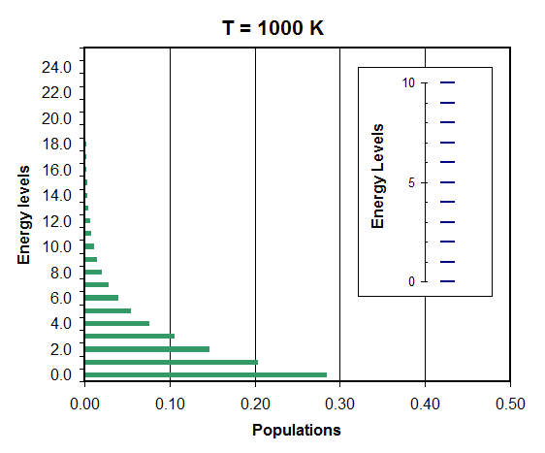
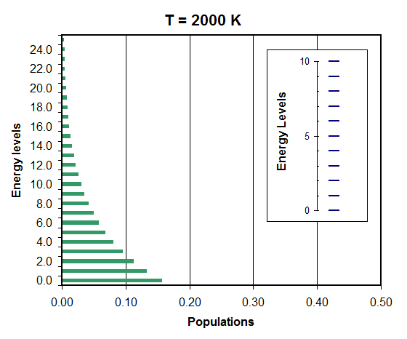
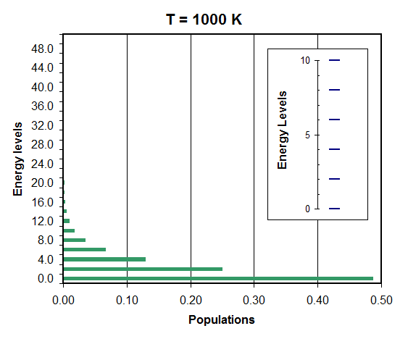
q(1000 K,1) = 3.5
q(2000 K,1) = 6.4
q(1000 K,2) = 2.2

Slide 46
Equilibrium and Partition Function
Isomerization
OH
OH

Slide 47
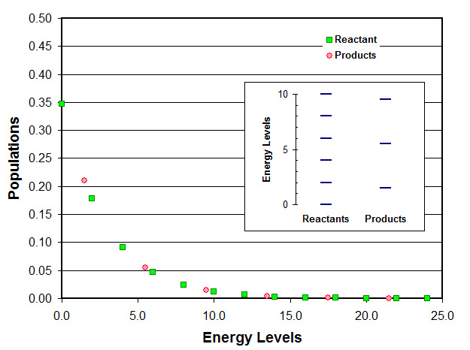
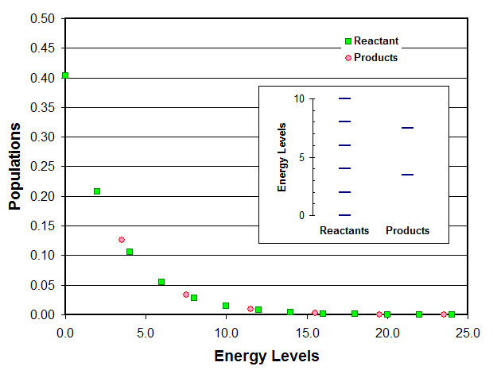
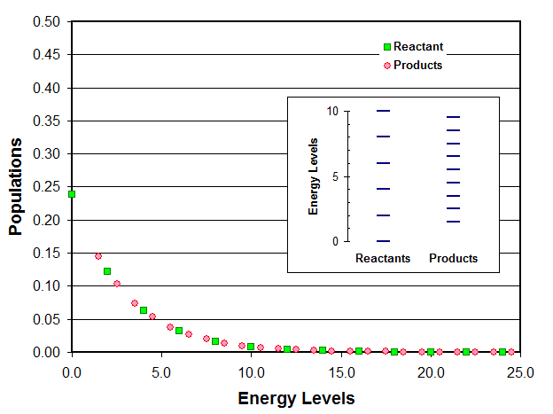
Contributions to the equilibrium constant
Reaction at equilibrium (reactants products)
Products
ΔE₀
Reactants

Slide 48
The ratio of reactants and products at equilibrium
At equilibrium both reactants and products are present
The equilibrium constant is the ratio of reactants and products at equilibrium
Products
ΔE₀
Reactants

Slide 49
Calculations

Slide 51
State of the system
Thermodynamic state (T,V,n, etc.)
Microscopic state (Quantum state: n,l,m_{l},m_{s})
Postulations
The measured time average of a macroscopic property in the system of interest is equal to the average value of that property in the ensemble.
For a thermodynamic systme of fixed volume, composition, and temperature (canonical ensemble), all quantum states (of the system) that have equal energy have equal probability of occuring.

Slide 52
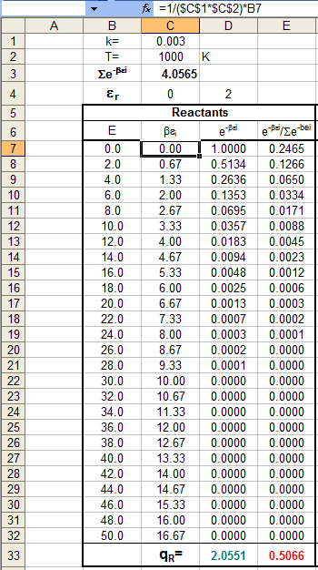
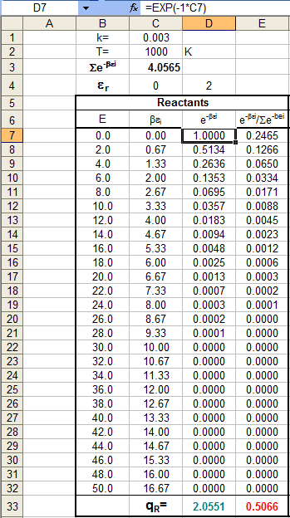

Slide 53
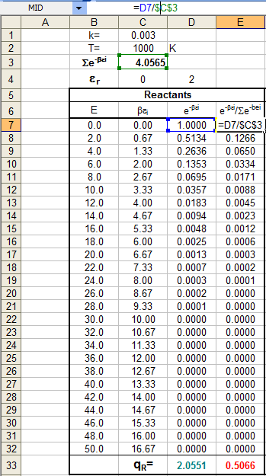
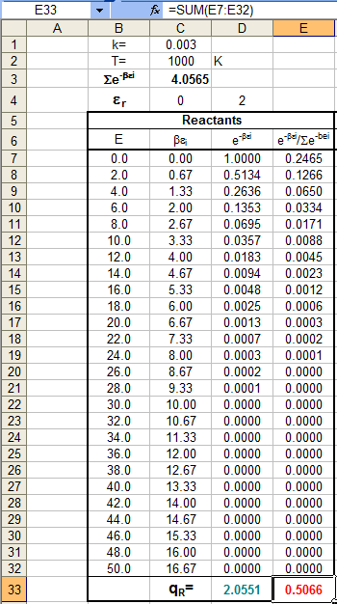

Slide 54
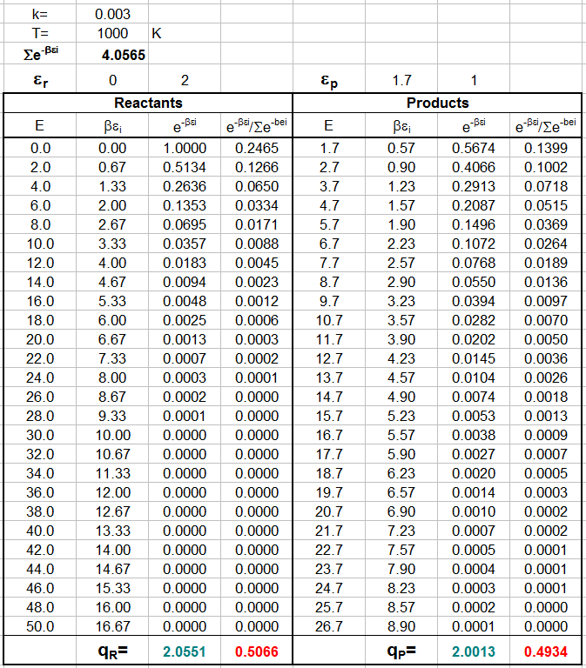

Slide 55
