Slide 1
งานเดี่ยว
สรุปเนื้อหาของวิชา (เนื้อหา 3 บทแรก)
สรุปเนื้อหาสั้น ๆ ของรายวิชาว่าเรียนเกี่ยวกับอะไร/มีประโยชน์อย่างไร
Powerpoint เนื้อหา 5 สไลด์
คะแนน 10 คะแนน ส่งหลังสงกรานต์
ความถูกต้องของเนื้อหา 2 คะแนน
ความสวยงาม ดูง่าย เรียบร้อย 3 คะแนน
รูปแบบ ไอเดีย การนำเสนอ การอธิบาย 5 คะแนน

Slide 2
Physical Chemistry III 01403343 Molecular Interactions
Piti Treesukol
Chemistry Department
Faculty of Liberal Arts and Science
Kasetsart University : Kamphaeng Saen Campus

Slide 3
คำถาม 14
แรงระหว่างโมเลกุลเกิดเนื่องจากอะไร
ทำไมถึงมองโมเลกุลเป็นไดโพล
ไดโพลจะวางตัวในทิศทางใดขึ้นกับอะไร

Slide 4
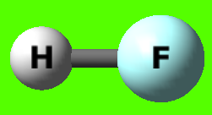
Charges Interactions
Coulombic Inteaction between q₁ and q₂
Partial atomic Charges Approximated distribution of electron in molecule
H F
H
0.387 -0.387
F
H F

Slide 5
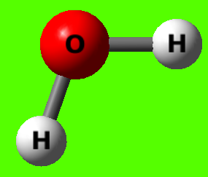
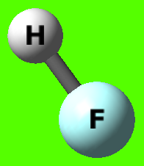
Molecular Interaction
0.387
-0.387
-0.84 0.42
0.42

Slide 6
Electric Properties of Molecules
Electric Dipole Moments
1D (debye) = 3.33564 ×10⁻³⁰ Cm
Permanent Electric Dipole Moment Due to the permanent difference in electron distribution
Electronegativity Difference
Molecular Symmetry
Induced Electric Dipole Moment An applied electric field or the repulsion from other molecules with permanent dipole can induce a dipole moment in the non-polar molecule.
μ
+q₁
-q₁
R

Slide 7
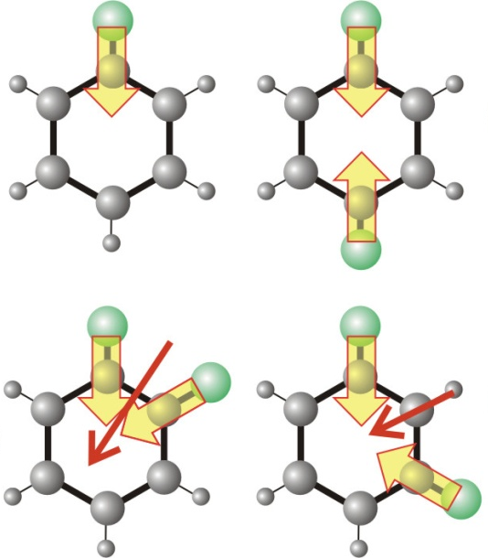
Dipole Moment of Molecules
Polar molecules is a molecule with a permanent dipole moment.
Diatomic molecules
Polyatomic molecules
1.08 D
0.12 D
H Cl
C O
μ
δ⁺
δ⁺
μ
μ
μ
O
δ⁻
+0.24
-0.12 -0.12
δ⁻
O
O

Slide 8
Polyatomic Molecules
Dipole moments are calculated considering a vector, μ, with three components, μ_{x}, μ_{y}, and μ_{z}. The direction of μ shows the orientation of the dipole in the molecule and the length of the vector is the magnitude, μ, of the dipole moment.
μ
μ_{z}
μ_{y}
μ_{x}

Slide 9
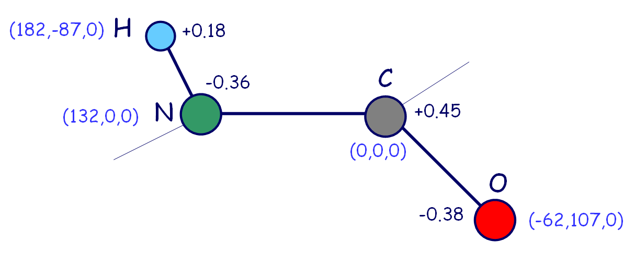
-y
x
μ
μ_{x} = (-0.36e) x (132 pm) + (0.45e) x (0 pm)+(0.18e) x (182 pm) + (-0.38e) x (-62 pm)
= 8.8 e pm
= 1.4 x 10⁻³⁰ C m = 0.42 D
μ_{y} = (-0.36e) x (0 pm) + (0.45e) x (0 pm)+(0.18e) x (-86.6 pm) + (-0.38e) x (107 pm)
= -2.7 D
μ_{z} = (-0.36e)

Slide 10
The Mean Electric Dipole Moment
The mean electric dipole moment of an isotropic fluid sample is zero in the absence of an applied field because the molecules adopt random orientation.
The probability that a dipole has an orientation in the range θ to θ+dθ is given by the Boltzmann distribution
E(θ) is the energy of the dipole in the field
E is the applied field
μ
θ
E

Slide 11
No electrostatic Field
E(θ) are all equal (0)
p(θ) are all equal
With electrostatic Field
E(θ) are different
p(θ) are different Low E(θ) = high p(θ)
θ
E
θ

Slide 12
Probability θ=30° p(30°)=?
Probabiltiy θ=30-40°
E
θ

Slide 13
In the presence of an electric field, the dipoles become partially aligned because some orientations have lower energies than others.
The average value of the component of the dipole moment parallel to the direction of the applied electric field (z) is

Slide 14
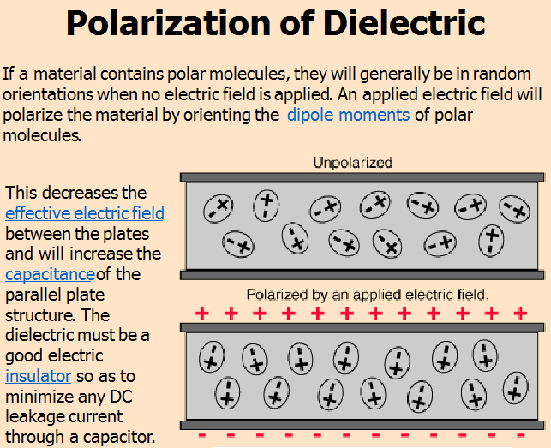
Polarization
The Polarization of a sample is the electric dipole moment density.

Slide 15
Polarizability
Polarizability is the relative tendency of a charge distribution, like the electron cloud of an atom or molecule, to be distorted from its normal shape by an external electric field, which may be caused by the presence of a nearby ion or dipole.
The induced dipole moment, μ* is proportional to the field strength.
α is the polarizability of the molecule
Polarizability volume
C² m² J⁻¹
C² J⁻¹ m⁻¹
The same magnitude as the actual molecular volumes (Å³)

Slide 16
คำถาม 15
Polarizability คืออะไร
ทำไมสารแต่ละชนิดมีค่าความจุความร้อนไม่เท่ากัน
ความจุความร้อนของสารแต่ละชนิดเป็นค่าคงที่หรือไม่เนื่องจากอะไร

Slide 17
สอบกลางภาค (ชดเชย)
วันศุกร์ที่ 22 เมษายน 2559 เวลา 17:00-19:30 ห้อง LH2-202
ปรนัยคล้ายเดิม อัตนัยน้อยลงและคำนวณง่ายขึ้น
นิยาม/ความหมาย (เพิ่ม)
จงสรุปขั้นตอนการคำนวณหาความน่าจะเป็นและค่าที่วัดได้ (เช่น พลังงาน ไดโพลโมเมนต์เฉลี่ย) เช่น
ระบบประกอบด้วยอนุภาค 500 ตัว โดยระดับพลังงานที่เป็นไปได้สำหรับแต่ละอนุภาคเท่ากับ 3i²+1 เมื่อ i=1-5 และอุณหภูมิเท่ากับ 1,000 K

Slide 18
Polarization due to External Field
Orientation Polarization: The polarization due to the permanent dipole moments (1ps/1π)
Distortion Polarization: The polarization due to the distortion of the positions of the nuclei by the applied field (1/ν)
Electronic Polarization: The distortion of the electron distribution

Slide 19
Polarization at High Frequencies
In real materials, the polarization does not respond instantaneously to an applied field. This causes dielectric loss.
When the applied field changes direction (alternating field) slowly, the permanent dipole moment has time to re-orientate.
At high frequencies, a molecule cannot change direction fast enough to follow the change in direction of the applied field and the dipole moment makes no contribution to the polarization of the sample.
The time taken for a molecule to bend is approximately the inverse of the molecular vibration frequency.
A dielectric material (dielectric) is an electrical insulator that can be polarized by an applied electric field

Slide 20
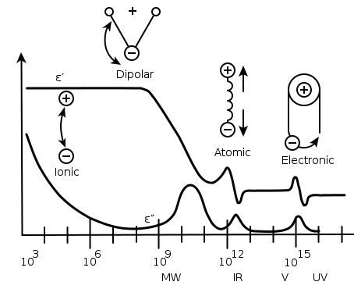
The variation of the polarizability with the frequency of the applied field
Orientation
Electronic
Distortion
Charge
Polarizability

Slide 21
Permittivity of the Medium
Permittivity is a physical quantity that describes how an electric field affects, and is affected by a dielectric (insulator) medium, and is determined by the ability of a material to polarize in response to the field, and thereby reduce the total electric field inside the material.
Permittivity relates to a material's ability to transmit an electric field.
Relative permittivity (ε_{r}) is the permittivity of material (ε) relative to the permittivity of vacuum (ε)

Slide 22
+
-
E
+
-
+
-
+
-
δ-
δ+

Slide 23
Relative Permittivities
Relative permittivity of the medium
The relative permittivity of a substance is large if its molecules are polar or highly polarizable.
Debye equation
Induced dipole moment
Permanent dipole moment
Molar polarization
Clausius-Mossotti equation
No contribution from permanent dipole moment*

Slide 24
Refractive Index
The refractive index of a medium is a measure for how much the speed of light is reduced inside the medium.
The refractive index at a specified frequency is related to the relative permittivity at that frequency
Speed of light in vacuum
Speed of light in the medium
+
+
+
+

Slide 25
Interaction between Molecules
Van der Waals force is the attractive or repulsive force between molecules (or between parts of the same molecule) other than those due to covalent bonds or to the electrostatic interaction of ions with one another or with neutral molecules.
permanent dipole–permanent dipole forces
permanent dipole–induced dipole forces
instantaneous induced dipole-induced dipole (London dispersion forces)

Slide 26
The Electric Field
E ₁ (r)
Electric field generated by a point charge:
Electric field generated by a dipole:
r
q₁
q₂
q₁
q₂

Slide 27
Interactions between Dipoles
The potential energy between a point dipole and the point charge q (l>>r)
+q₁
-q₁
q₂
q₂
l
r
r
θ
l
+q₁
-q₁

Slide 28
+q₁
-q₁
Increasing the distance, the potentials of the charges decrease and the two charges appear to merge.
These combined effect approaches zero more rapidly than by the distance effect alone.
q₂
l
r
q₂
l
r
q₂
l
r

Slide 29
The potential energy between two parallel dipoles
l
-q₁
+q₂
-q₂
+q₁
+q₂
-q₂
θ
r
l
l
+q₁
-q₁
r
l
This applies to polar molecules in a fixed, parallel, orientation in a solid.

Slide 30
Freely rotating dipoles: Liquid, Gas
The interaction energy of two freely rotating dipoles is zero.
Real molecules do not rotate completely freely due to the fact that their orientations are controlled partially by their mutual interaction.

Slide 31
The average interaction energy of two polar molecules rotating at a fixed separation r
Probability that a particular orientation is given by Boltzmann distribution
Keesom Interaction
Average interaction is attractive.

Slide 32
Significance of Dipole-Dipole interaction
At 25°C the average interaction energy for pairs of molecules with μ = 1 D is about -1.4 kJ mol⁻¹ when the separation is 0.3 nm.
This energy is comparable to average molar kinetic energy of 3/2 RT = 3.7 kJ mol⁻¹ at 25°C.
These are similar but much less than the energies involved in the making and breaking of chemical bonds.

Slide 33
Dipole-Induced-dipole Interaction
A polar molecule with dipole moment μ₁ can induce a dipole μ₂ in a neighboring polarizable molecule.
The average dipole-induced dipole interaction energy is
*
Polar molecule
Polarizable molecule
Permanent dipole
Polarizability volume
Polar molecule
Polarizable molecule

Slide 34
Induced dipole-Induced dipole Interactions
Nonpolar molecules attract one another even though neither has a permanent dipole moment.
Any induced dipoles can generate electric field that polarizes other molecules.
The interaction is called either the dispersion interaction or the London interaction.
The dispersion interaction generally dominates all the interactions between molecules other than hydrogen bonds.
Polarizable molecules

Slide 35
Type | Distance dependence | Energy | Comment
Ion-ion | 1/r | 250 | Only ions
Ion-dipole | 1/r² | 15
Dipole-dipole | 1/r³ | 2 | Stationary
 | 1/r⁶ | 0.6 | Rotating
London | 1/r⁶ | 2 | All types

Slide 36
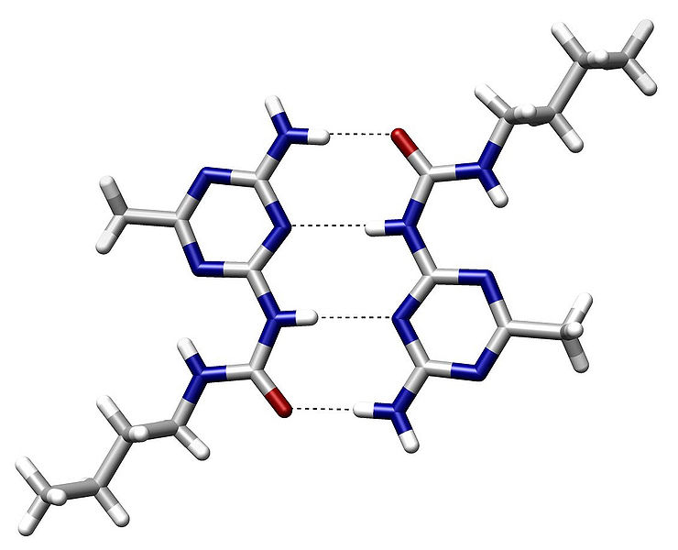
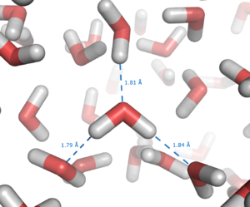
Hydrogen Bonding
A hydrogen bond is the attractive force between the hydrogen attached to an electronegative atom of one molecule and an electronegative atom of a different molecule.
A dipole-dipole force with a hydrogen atom bonded to nitrogen, oxygen or fluorine.
The energy of a hydrogen bond is typically 5 to 30 kJ/mole.
These bonds can occur between molecules or within different parts of a single molecule.
The hydrogen bond is a very strong fixed dipole-dipole van der Waals-Keesom force, but weaker than covalent, ionic and metallic bonds.

Slide 37
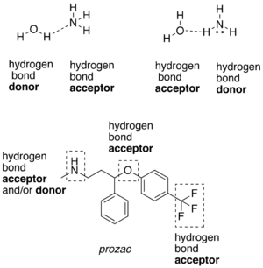
A hydrogen atom attached to a relatively electronegative atom (usually fluorine, oxygen, or nitrogen) is a hydrogen bond donor.
An electronegative atom such as fluorine, oxygen, or nitrogen is a hydrogen bond acceptor, regardless of whether it is bonded to a hydrogen atom or not.
Hydrogen bond Strength
F—H...F 40 kcal/mol O—H...N 6.9 kcal/mol O—H...O 5.0 kcal/mol N—H...N 3.1 kcal/mol N—H...O 1.9 kcal/mol HO—H...OH₃⁺ 4.3 kcal/mol
The length of hydrogen bonds depends on bond strength, temperature, and pressure.
The typical length of a hydrogen bond in water is 1.97 Å.

Slide 38
Repulsive and Total Interactions
The total attractive interaction between rotating molecules with no hydrogen bonding is the sum of van der Waals contributions.
When molecules are squeezed together, nuclear and electronic repulsions and the rising electronic kinetic energy begin to dominate the attractive forces.
Mie potential (General form)
Lennard-Jones potential
Repulsive (short-range)
Attractive (long-range)

Slide 39
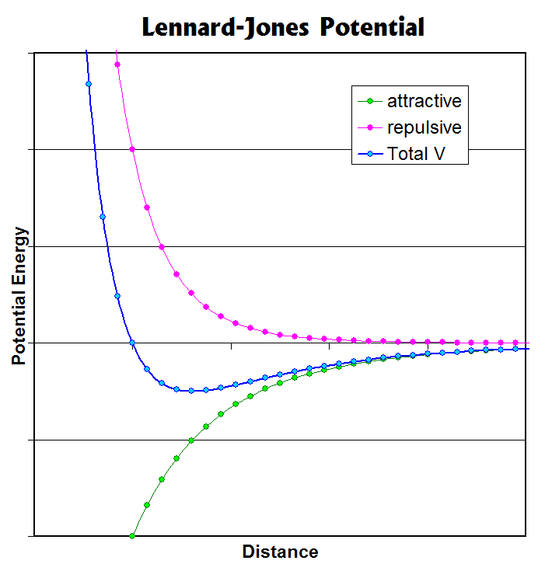
r₀
2^{1/6} r₀
ε

Slide 40
